Slide 1
Reinforcement Learning Based Mechanical Design and Control of Flexible-legged Jumping Robots
Andrew Albright
Department of Mechanical Engineering
University of Louisiana at Lafayette
andrewstevenalbright@gmail.com

Slide 2
Presentation Outline
Motivation for Work
Reinforcement Learning Overview
Related Work
Monopode System Overview
Learning Efficient Jumping Strategies
Learning Mechanical Design Parameters
Concurrent Design with RL
Future Research Enabled

Slide 3
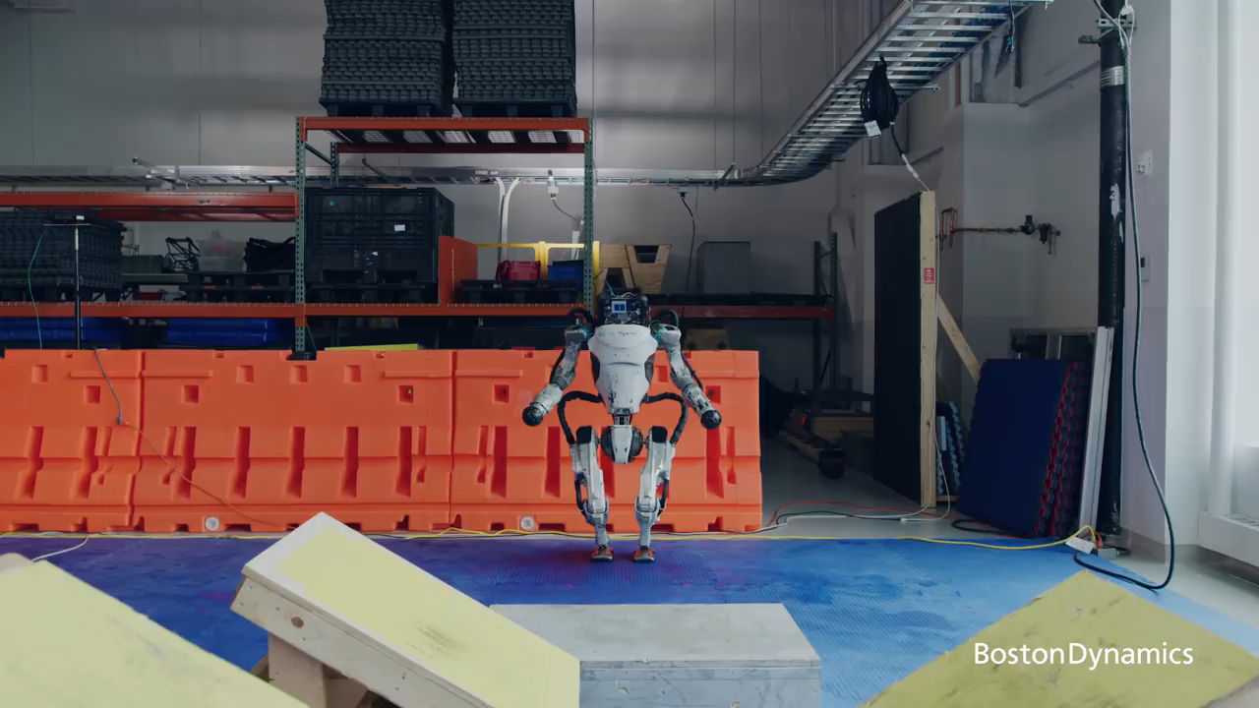
Legged Robotic Systems
Atlas | Partners in Parkour - YouTube
Notes:
Boston Dynamics Atlas Robot
Running/Jumping/Mantling
Extremely Harsh Terrain
No wheeled or tracked vehicle could navigate this terrain
Using Additional Appendages

Slide 4
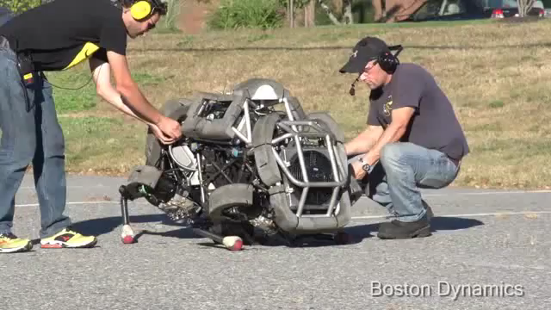
Power Consumption
Introducing WildCat. - YouTube
Notes:
Scaling to larger systems can be a challenge
Power consumption is major issue when scaling electrical systems
Using motors like the one seen in this video is one route
They do not provide the same performance benefits as electric motors
They are also extremely loud

Slide 5
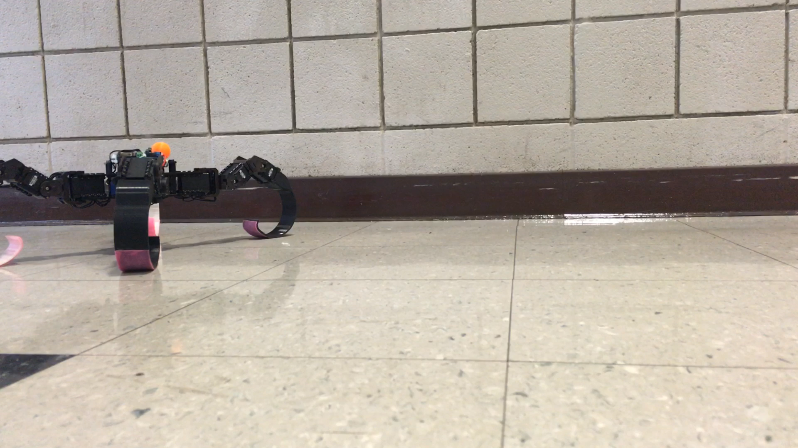
Flexible Legged Systems
Pros
Increases in efficiency
Better stability through adaptability
Higher performance
Running speed
Jumping height
Cons
Difficult to define models for due to nonlinearities
Challenging to create controllers for
Notes:
A solution to increase performance measures like efficiency
Have also been shown to increase adaptability
Increases in

Slide 6
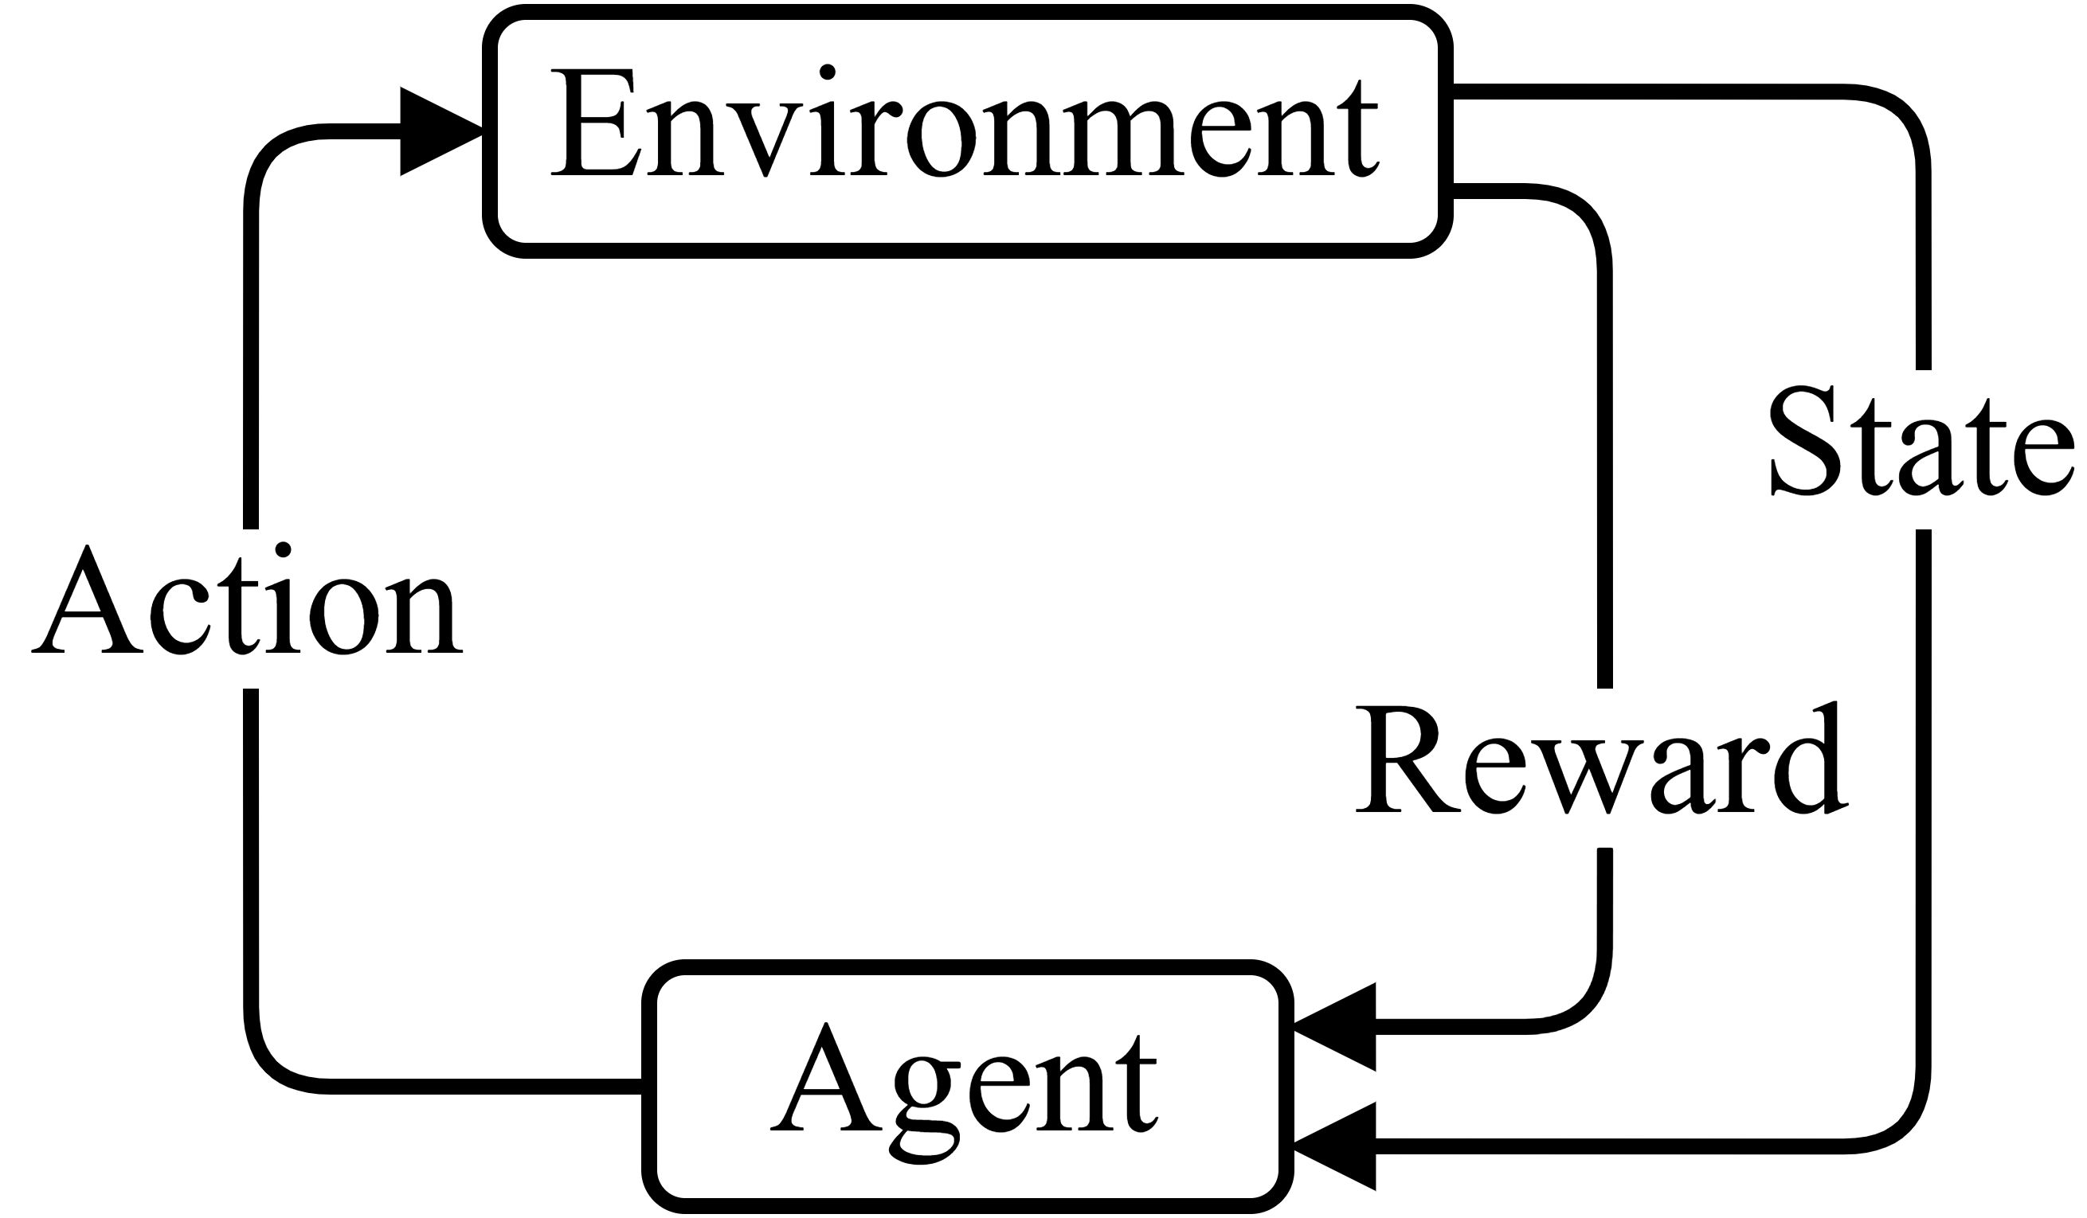
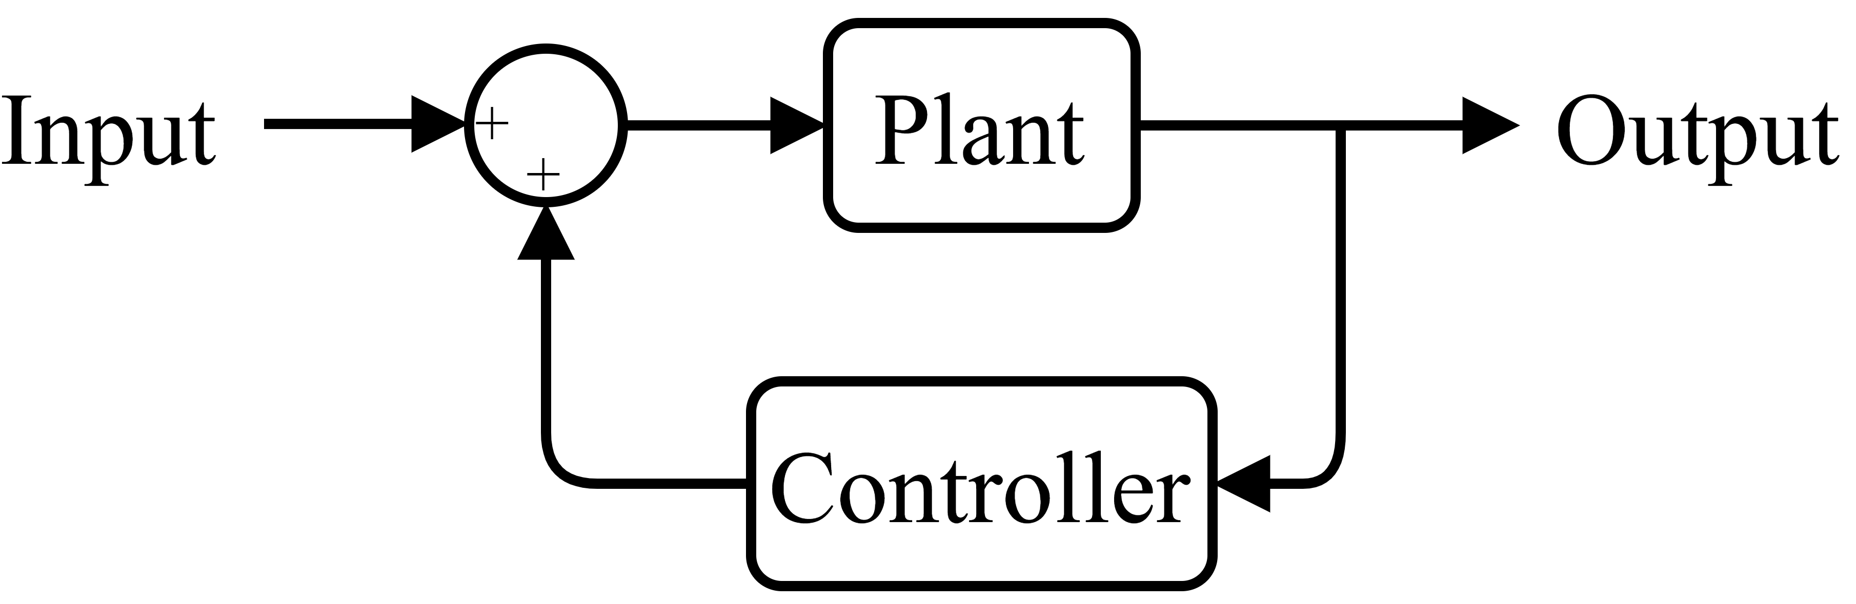
Learning a Control Strategy
Notes:
Reinforcement Learning
Has been used to learn system models as well as controllers
Has shown success in many different robotic applications
Has further shown success when deploying on real hardware

Slide 7
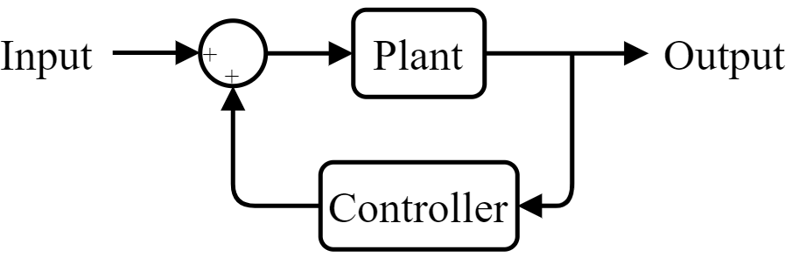
Learning a Control Strategy
Notes:
Reinforcement Learning
Has been used to learn system models as well as controllers
Has shown success in many different robotic applications
Has further shown success when deploying on real hardware

Slide 8
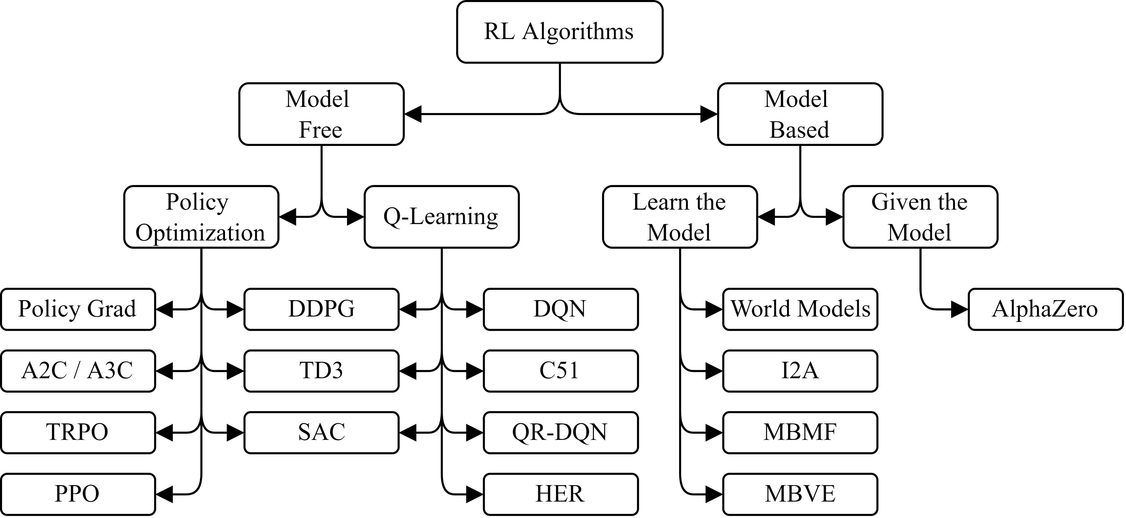
Learning Algorithms
Notes:
RL is a pretty big term though
Lots of ways it is used in general and lots of ways even just in regards to robotics applications
A bit about model-based stuff

Slide 9
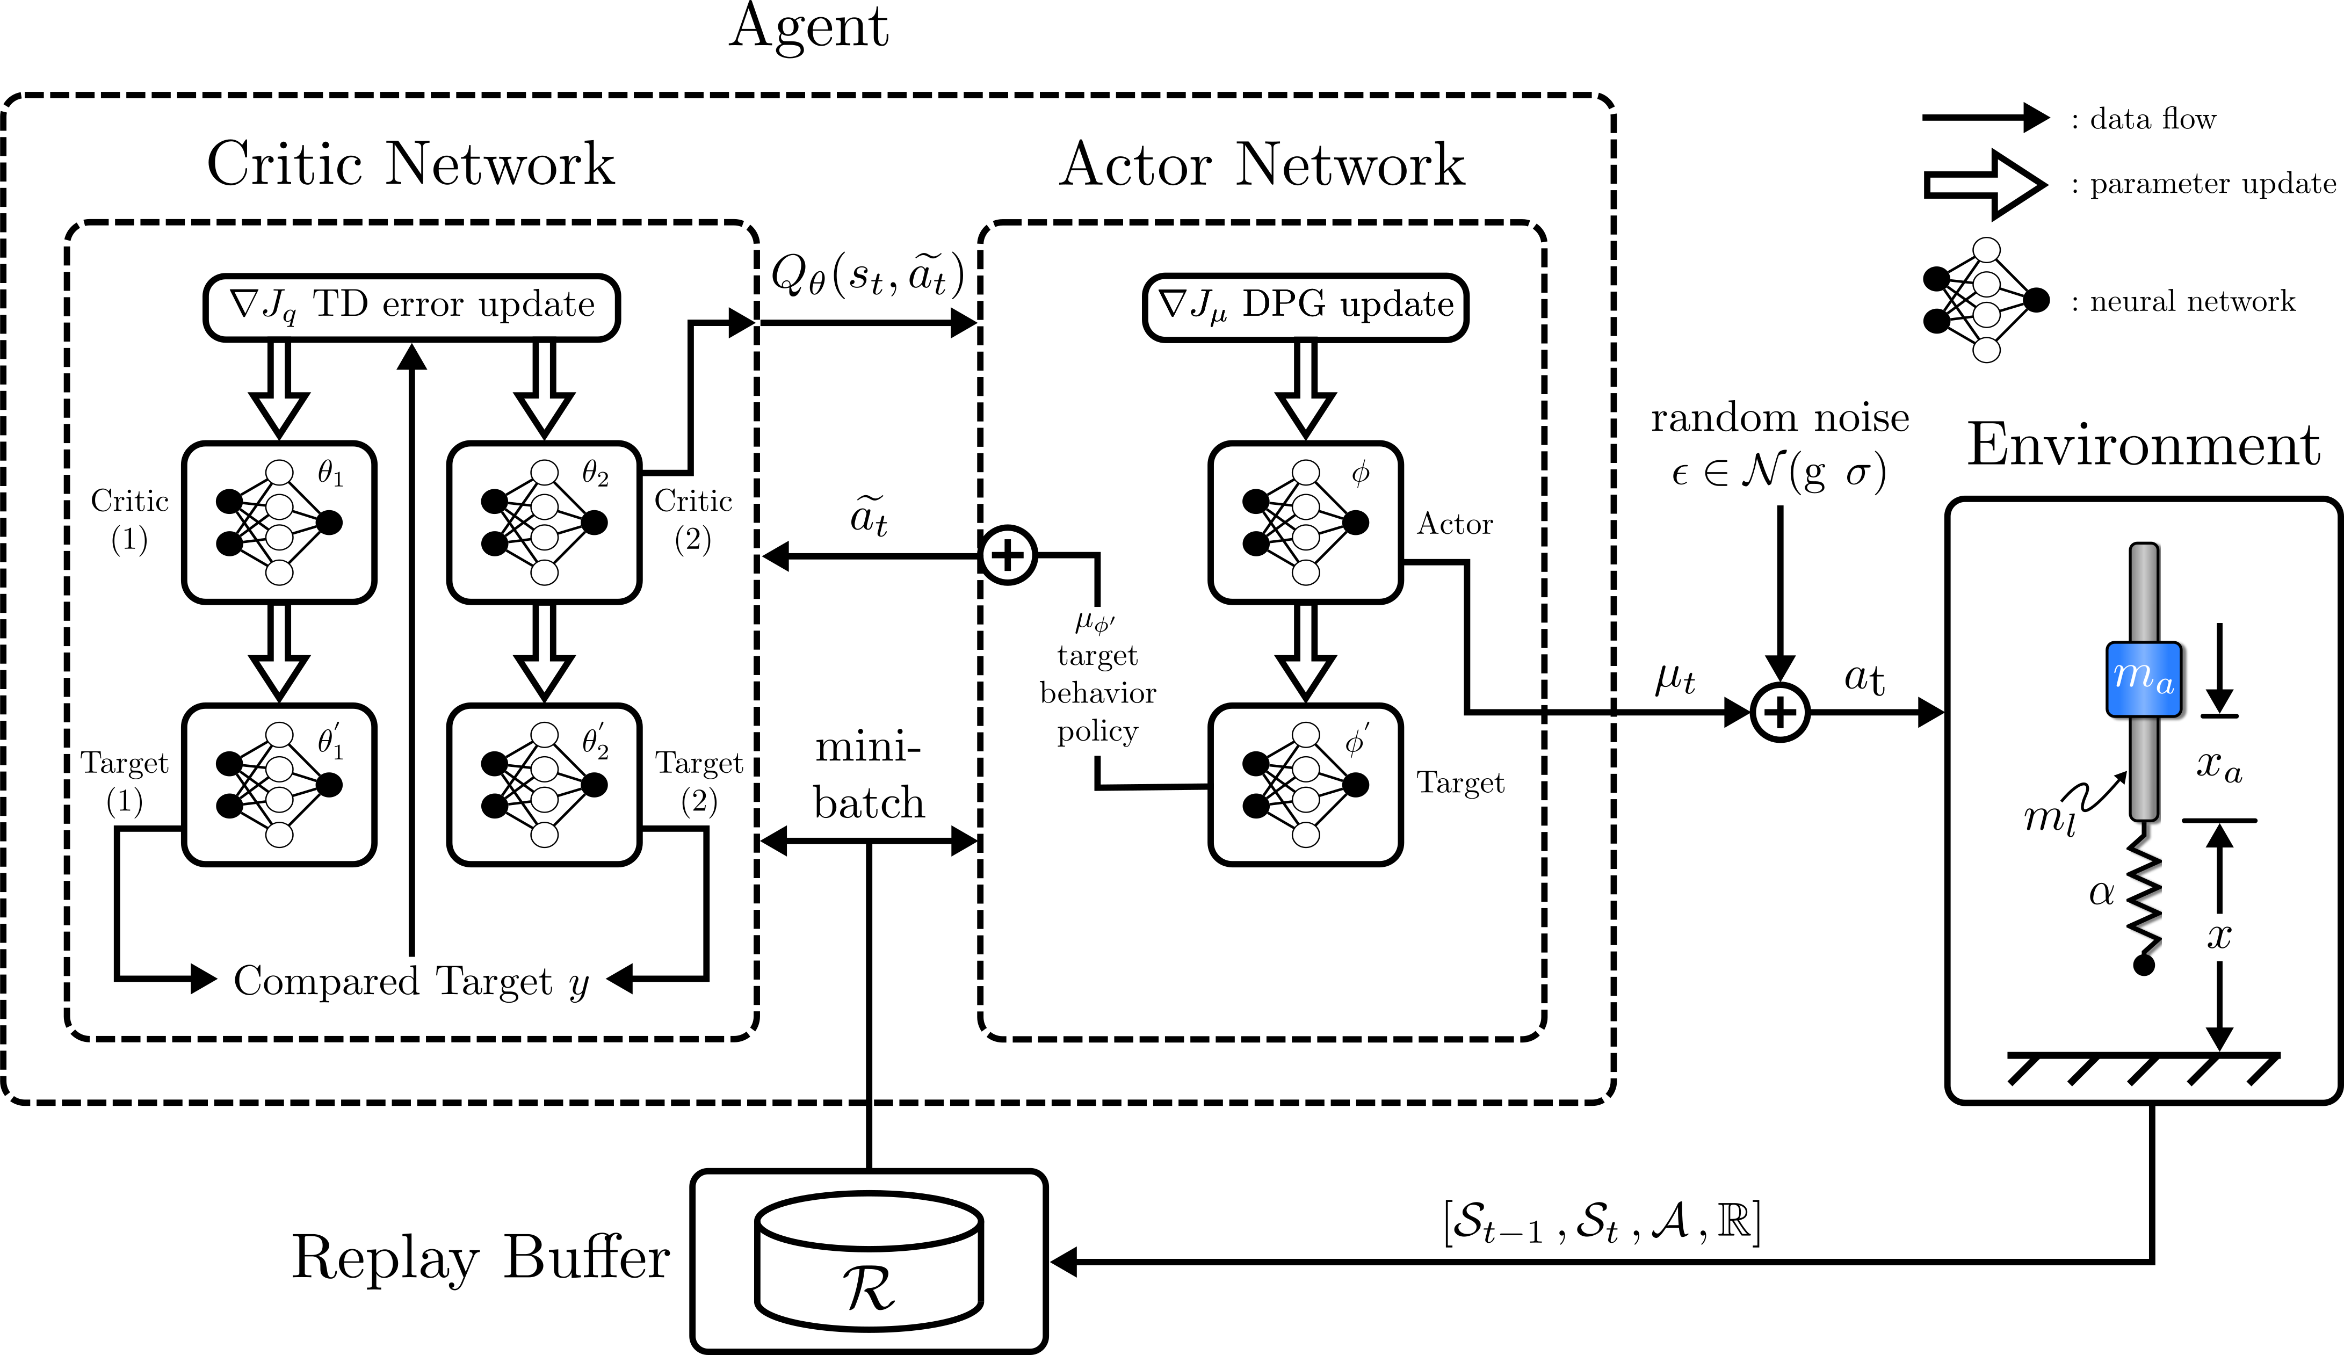
Twin Delayed DDPG
Notes:
How would we learn to control this system first? Or any system?
Like mentioned earlier the majority of the work we have done has utilized the TD3 algo
Actor-Critic algo
Learns Off-Policy through the replay buffer
Is for learning in continuous action spaces

Slide 10
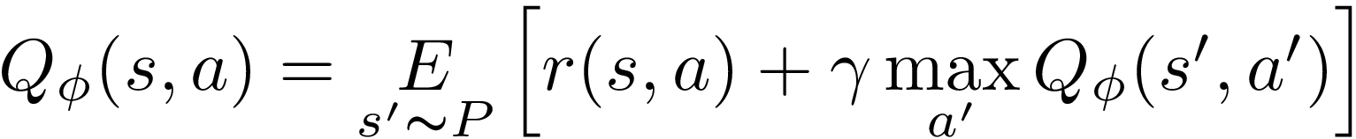
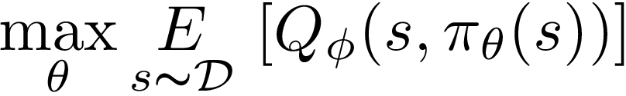
TD3 Equations
Update Critic
Update Actor

Slide 11
TD3 Tricks
Action Clipping
Twin Q-functions (Critics)
Delayed Actor Update

Slide 12
Related Work
Learning control for legged robotic systems
Using RL (DDPG, TD3, PPO, SAC)
Using Evolutionary Algorithms
Controlling Flexible Robots
Planar Manipulator
Simulation Running Robots
Design For Legged Locomotion
Increase efficiency using flexible links
Utilize elastic joints

Slide 13
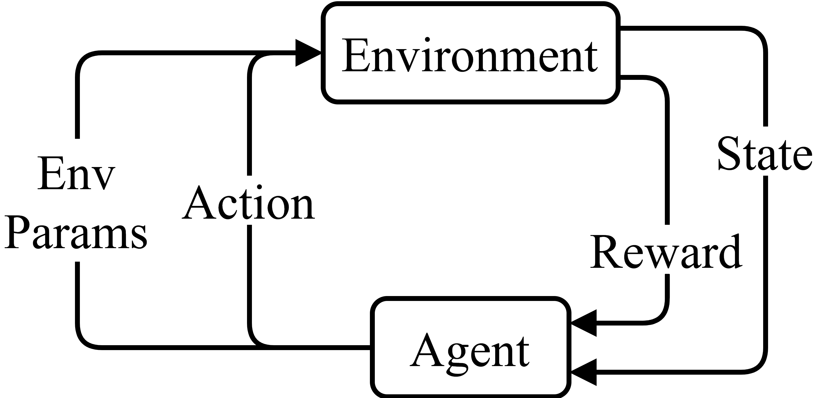
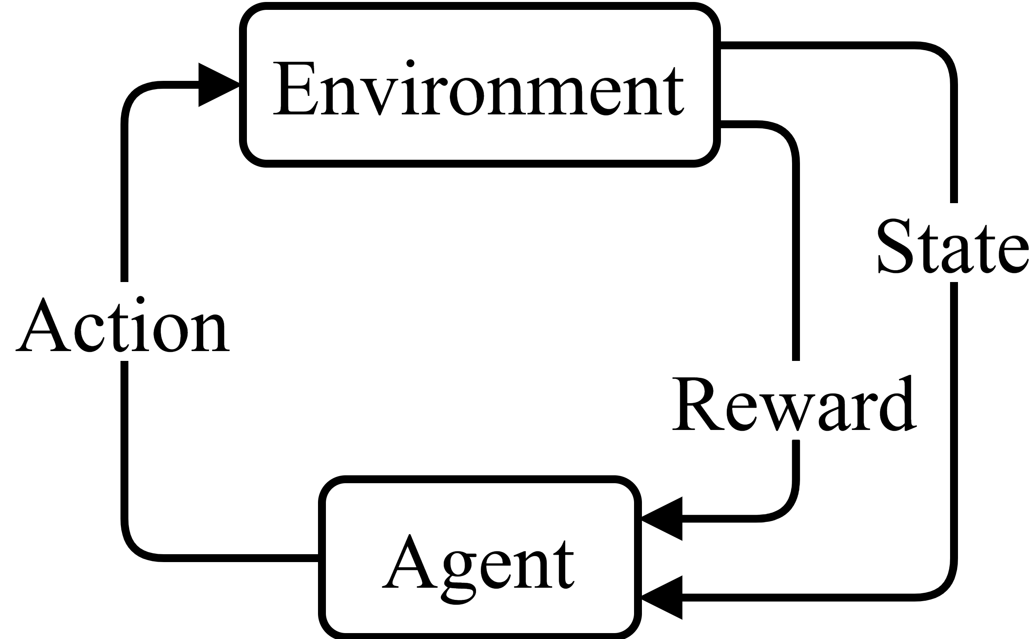
Concurrent Learning
Notes:
Interested in learning both design and control though right
Take what we have and know can work for control and apply design into the mix
This is not an entirely new concept and has shown some success in robotics research
We will first split this task into two parts and discuss them individually, then we will discuss joining them

Slide 14
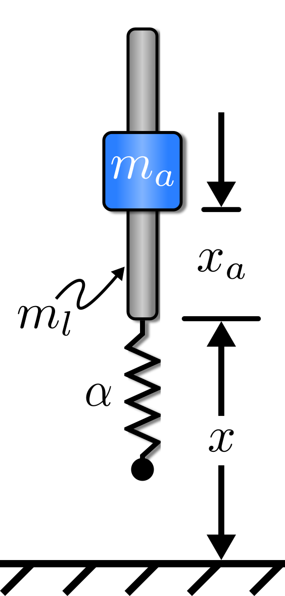
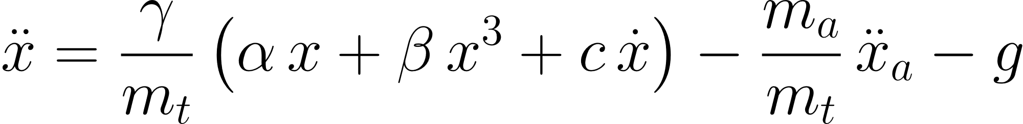
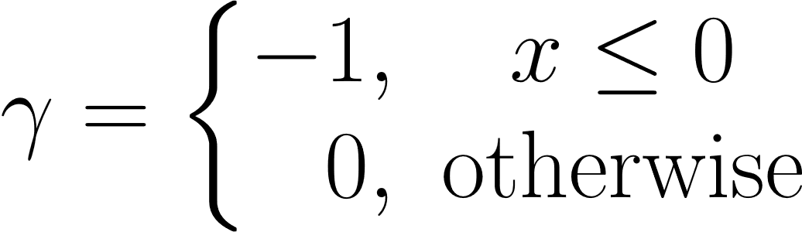
Monopode Jumping System
Notes:
Double Mass/spring/damper jumping system w/ discontinuous dynamics
Controlled by moving the actuator mass m_a along the rod mass m_l
Gamma
Spring limit

Slide 15
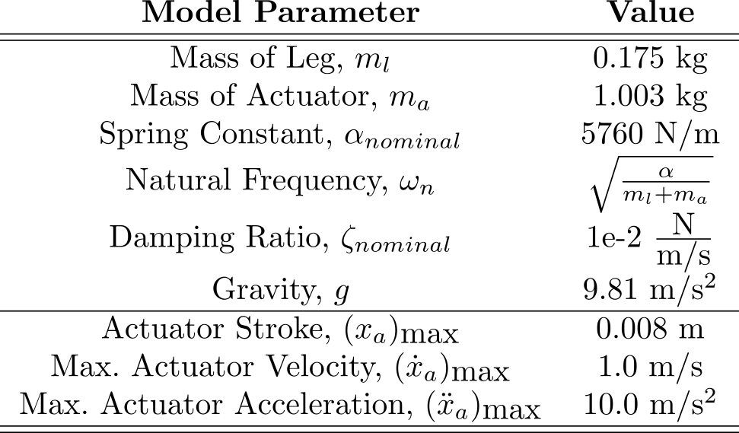
Monopode Parameters

Slide 16
Presentation Outline
Motivation for Work
Reinforcement Learning Overview
Related Work
Monopode System Overview
Learning Efficient Jumping Strategies
Learning Mechanical Design Parameters
Concurrent Design with RL
Future Research Enabled

Slide 17
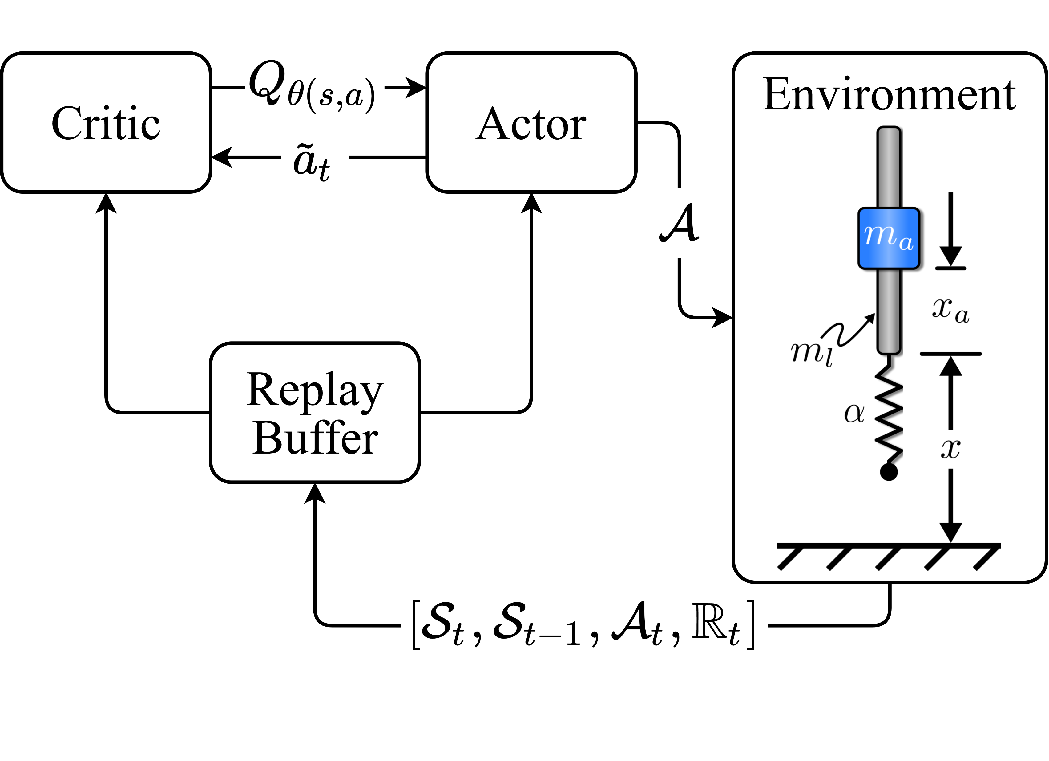
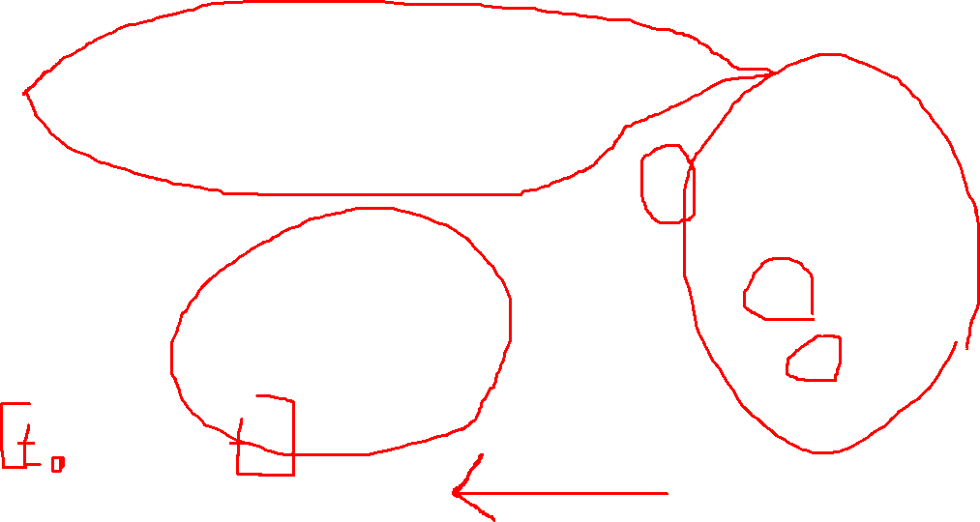
Learn Efficient Control
Notes:
How would we learn to control this system first? Or any system?
Like mentioned earlier the majority of the work we have done has utilized the TD3 algo
Actor-Critic algo
Learns Off-Policy through the replay buffer
Is for learning in continuous action spaces

Slide 18
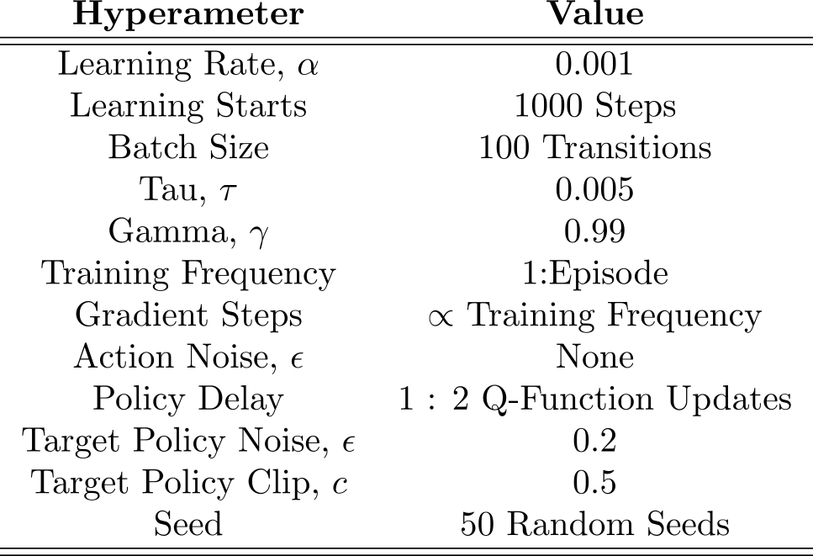
Training Hyperparameters

Slide 19
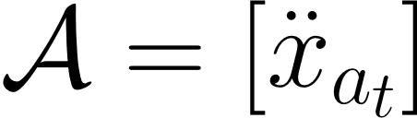
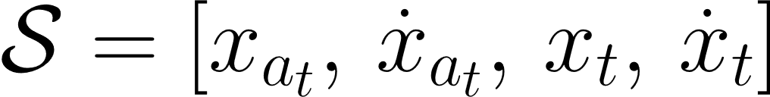
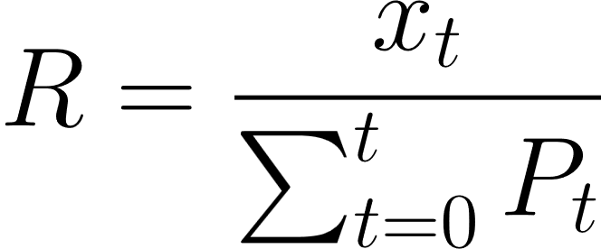
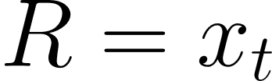

Environment Setup
Action Space
Observation Space
Reward(s)
High
Reward
Efficient
Reward
Notes:
action: acceleration
State transitions: state valriables

Slide 20
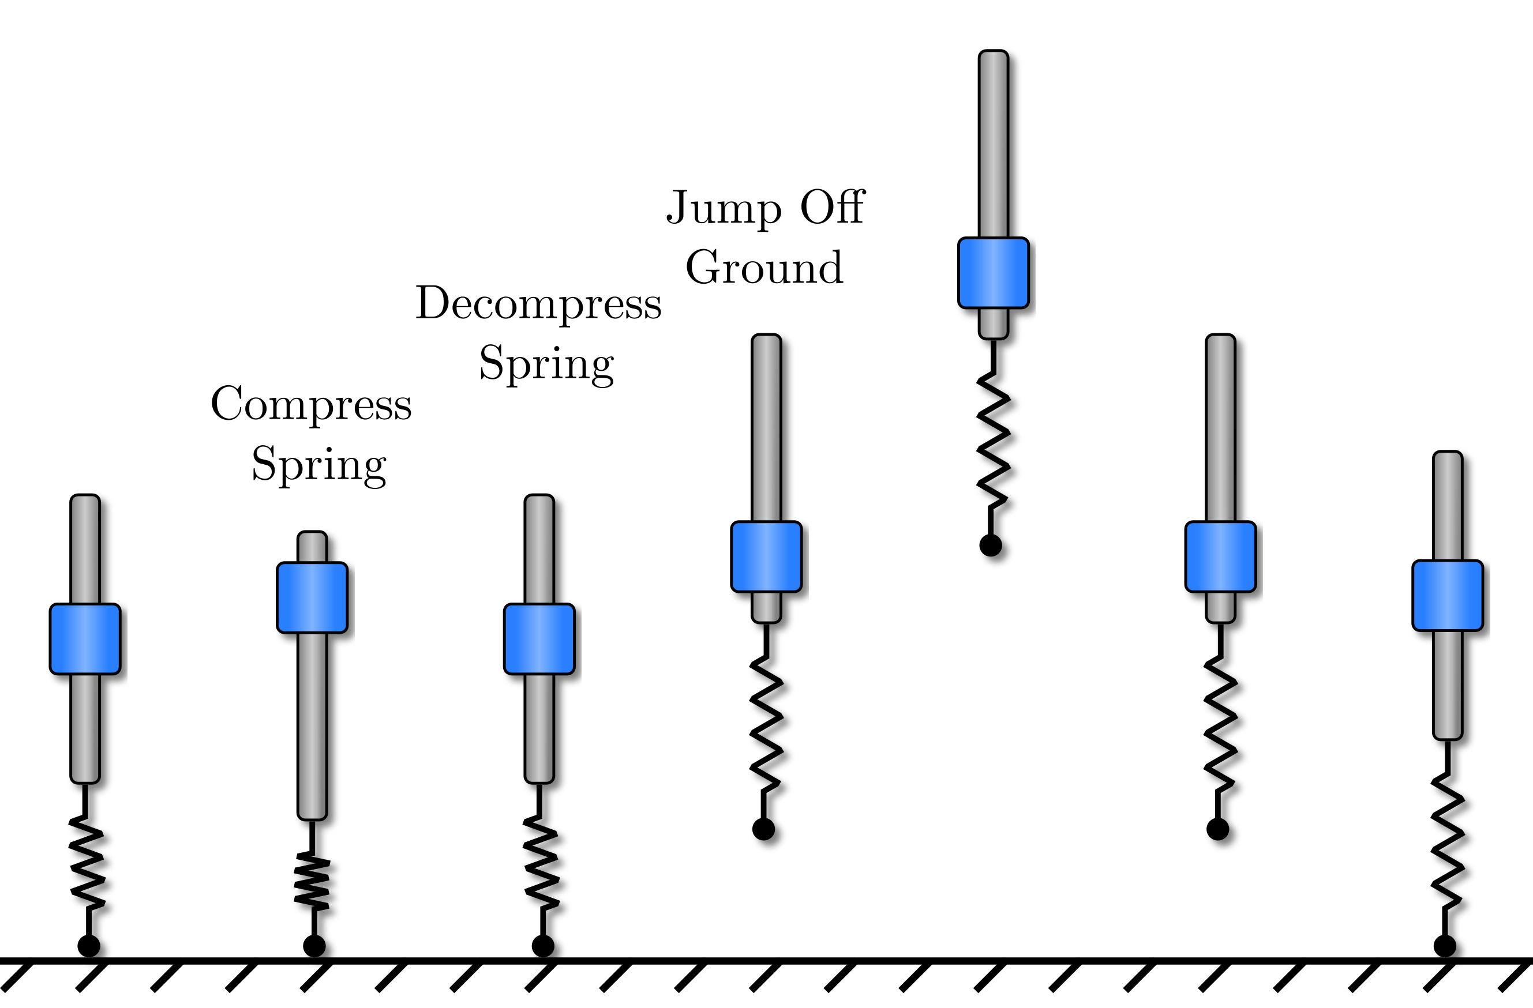
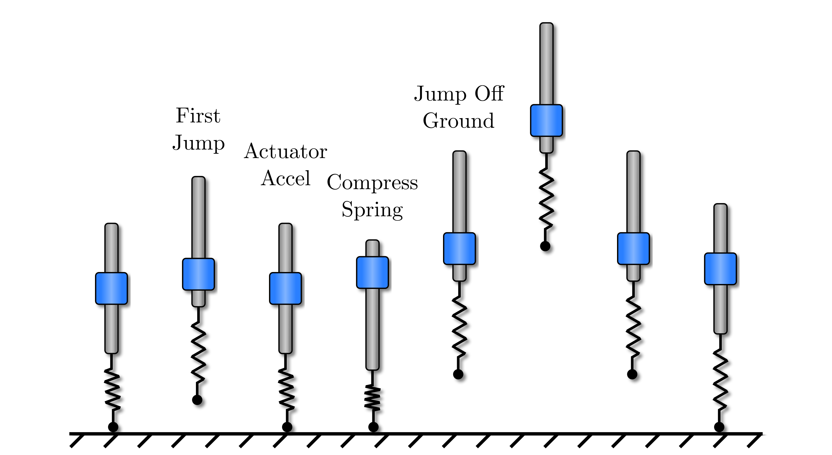
Evaluate Different Commands
Single Jump
Command
Stutter Jump
Command
Notes:
Often it is of interest to see how an agent trained to do one thing, performs on another
We can train different agents on different tasks and evaluate their performance to
We will not go over the learned control for the single jump

Slide 21
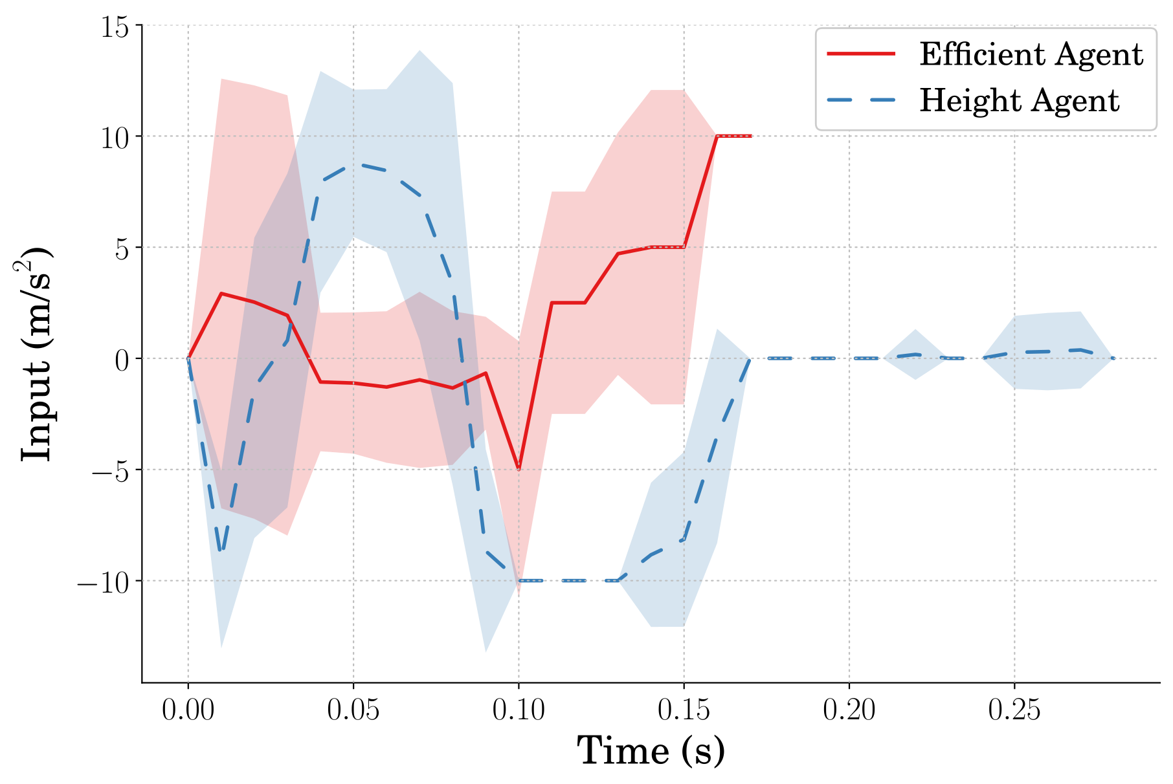
Single Jumping Input

Slide 22
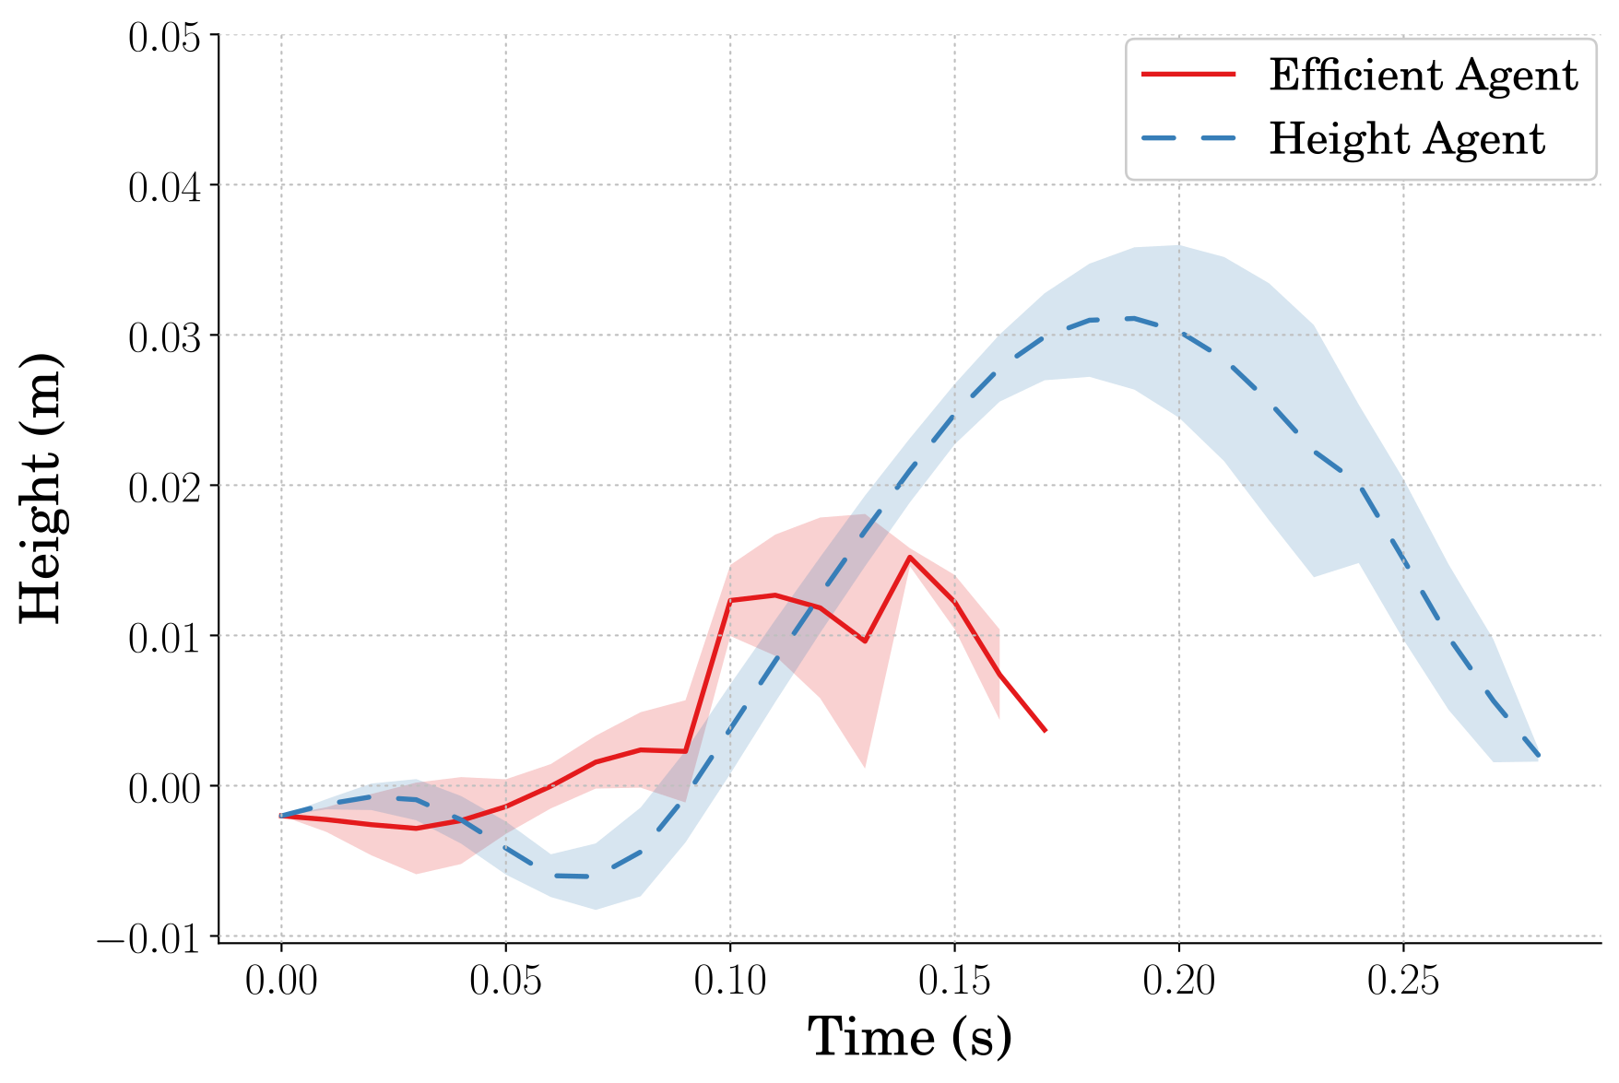
Single Jumping Height
Notes:
104% Higher

Slide 23
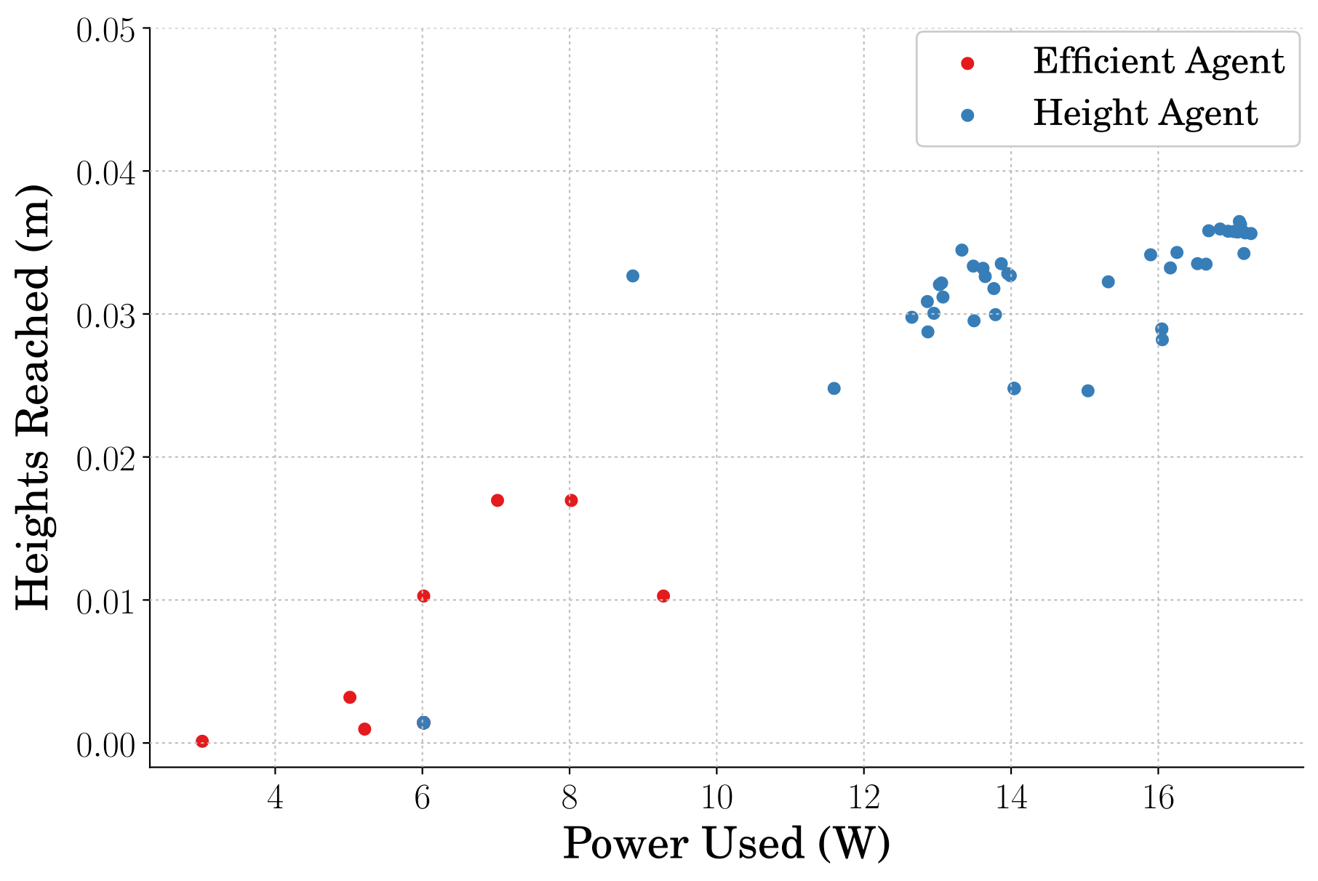
Single Jumping Efficiency
Notes:
126% more efficient

Slide 24
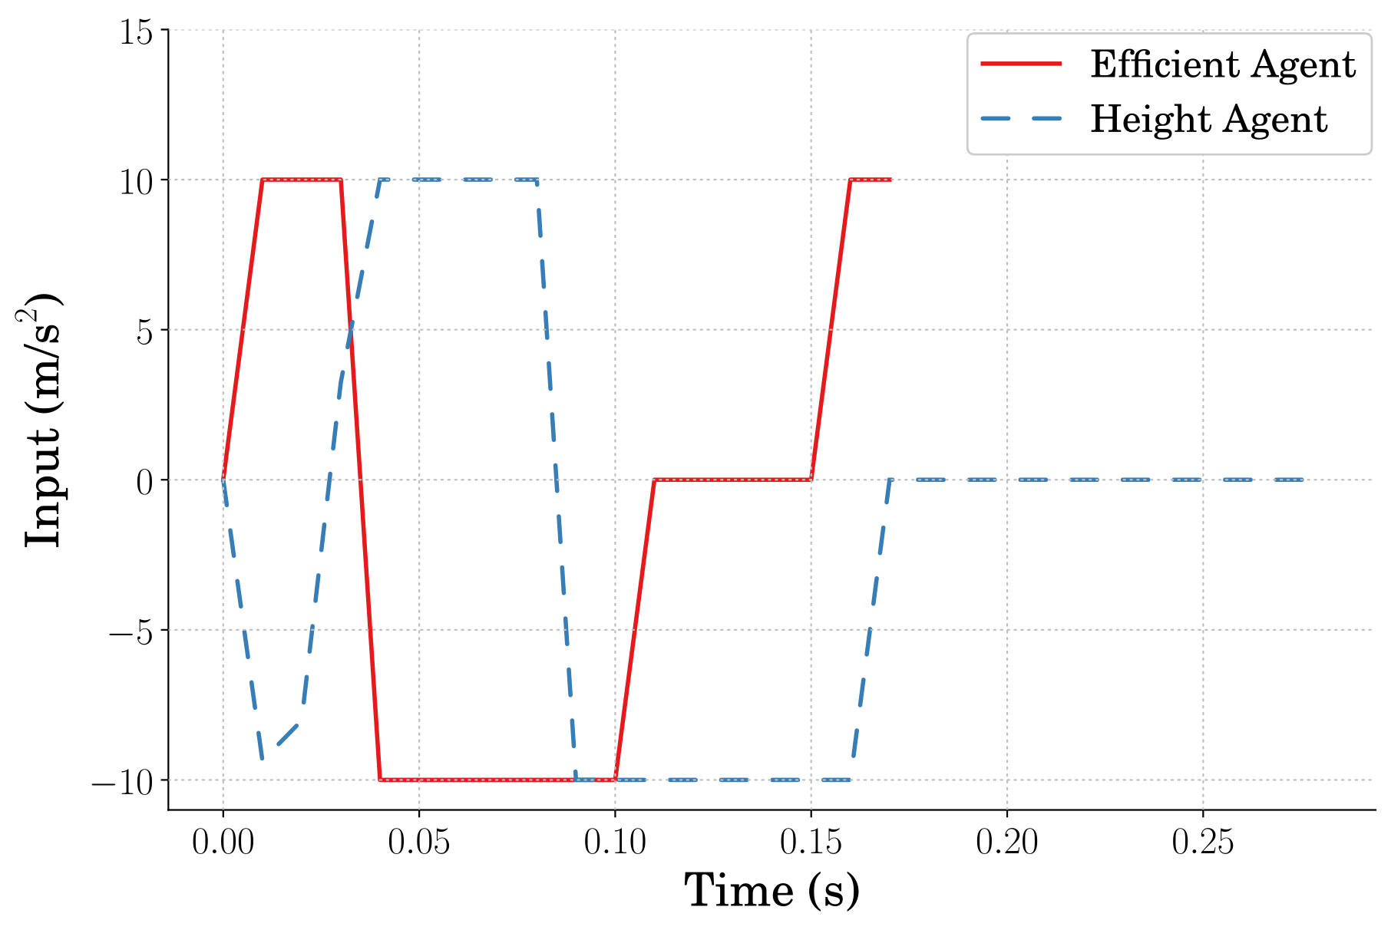
Best Single Jumping Input

Slide 25
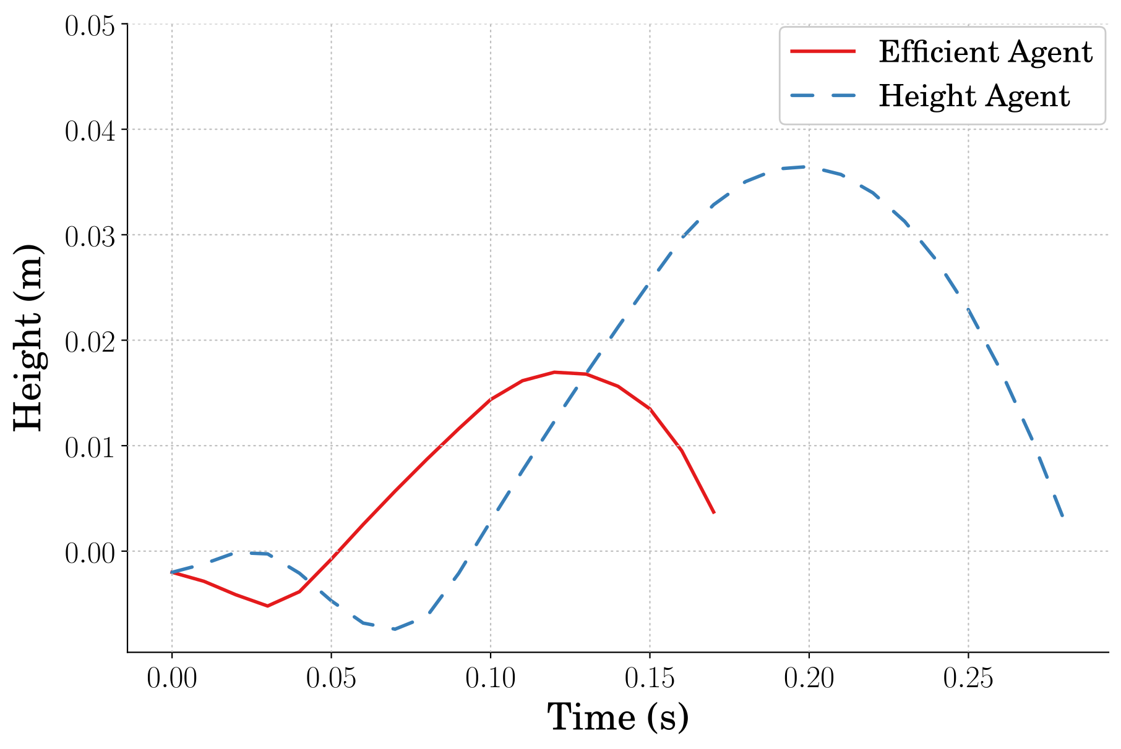
Best Single Jumping Height

Slide 26
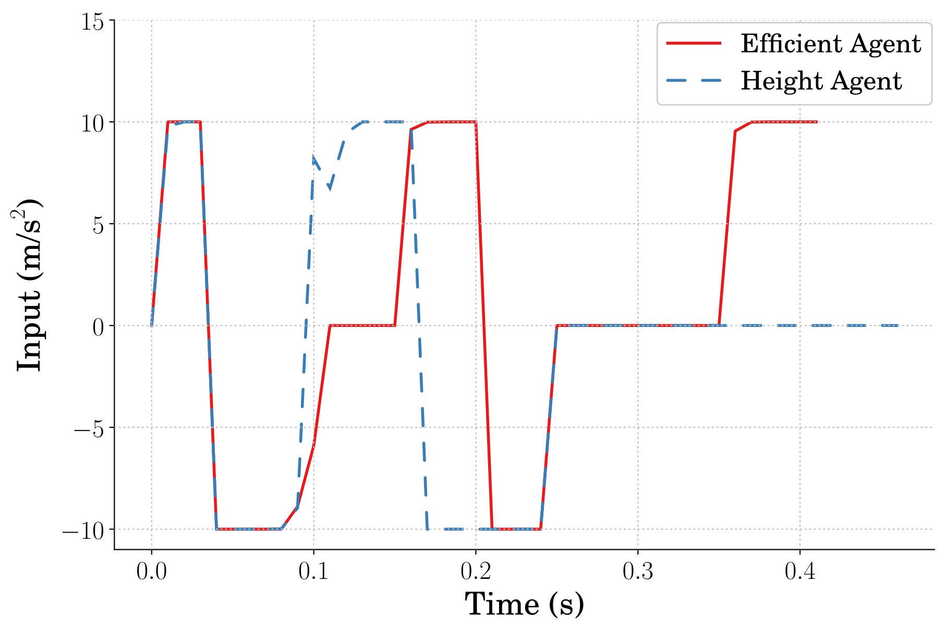
Best Stutter Jumping Input
Notes:
What if we take the best of all the agents and compare them?

Slide 27
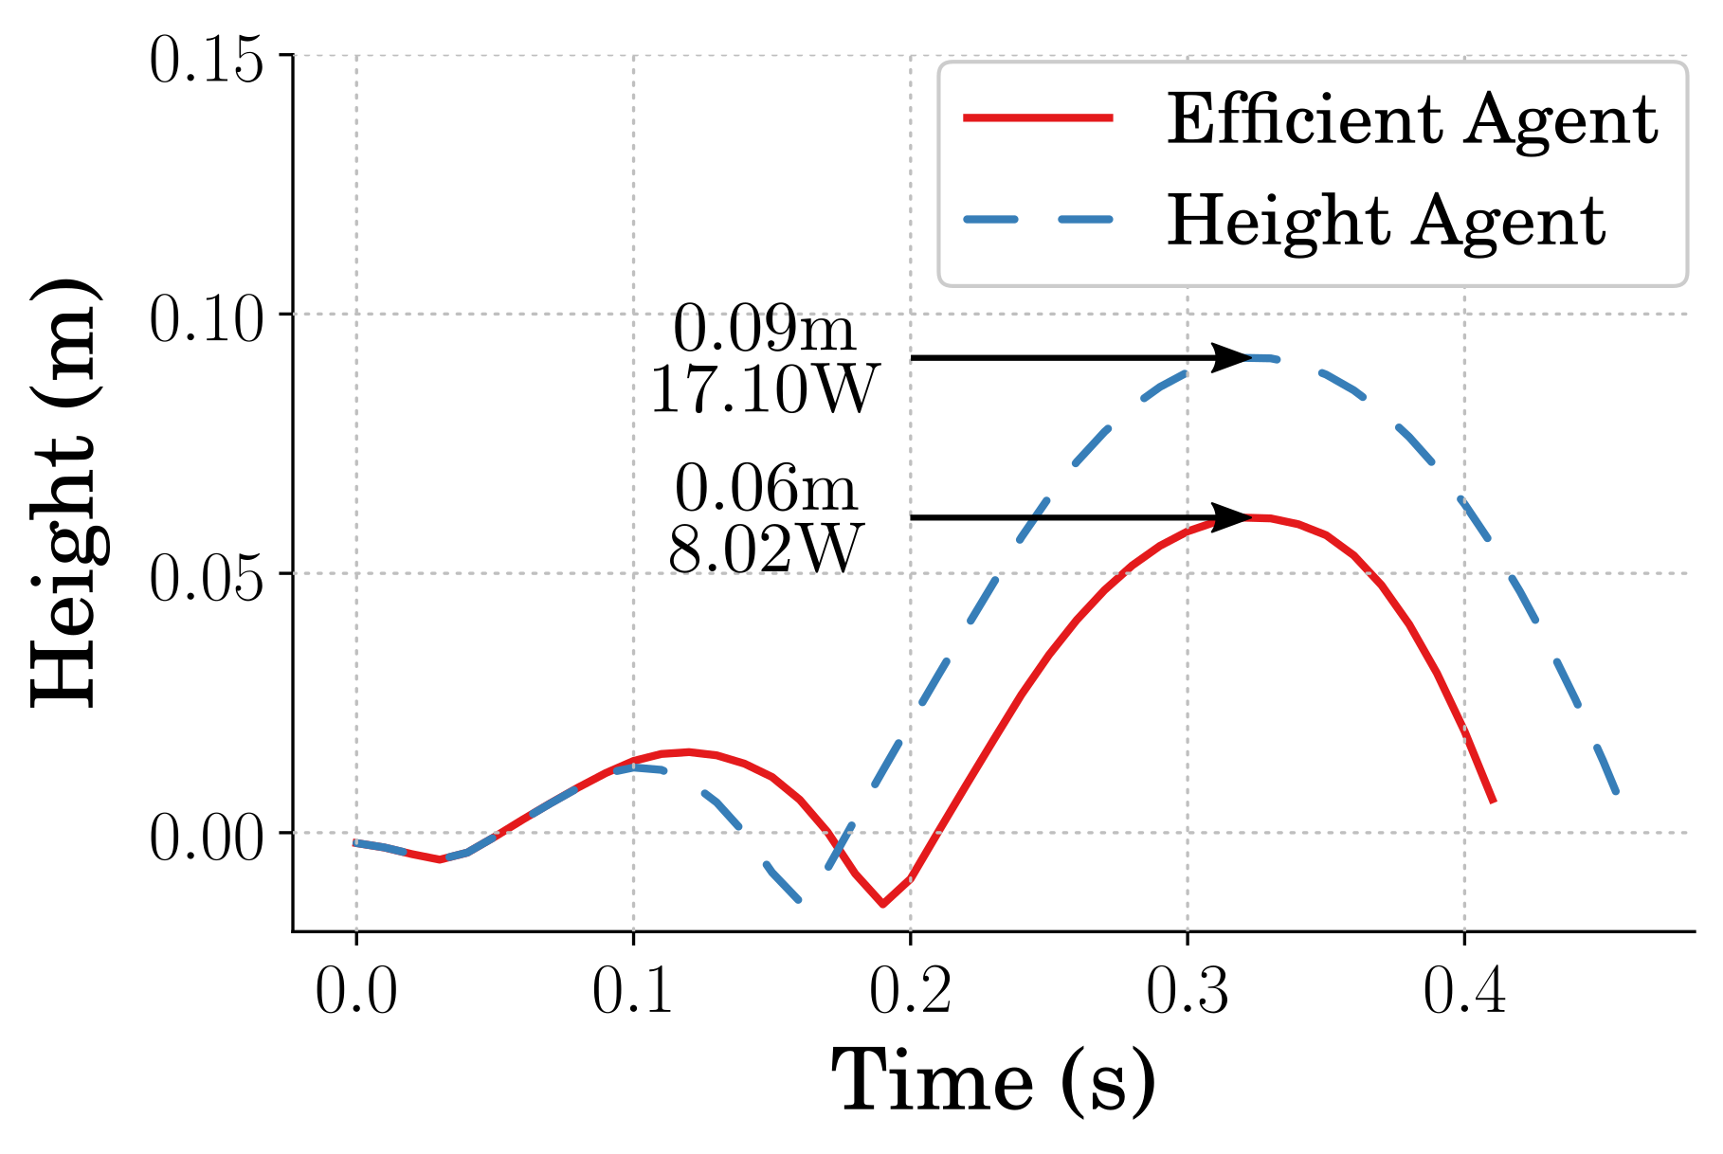
Best Stutter Jumping Height
Notes:
50% higher at 113% power cost

Slide 28
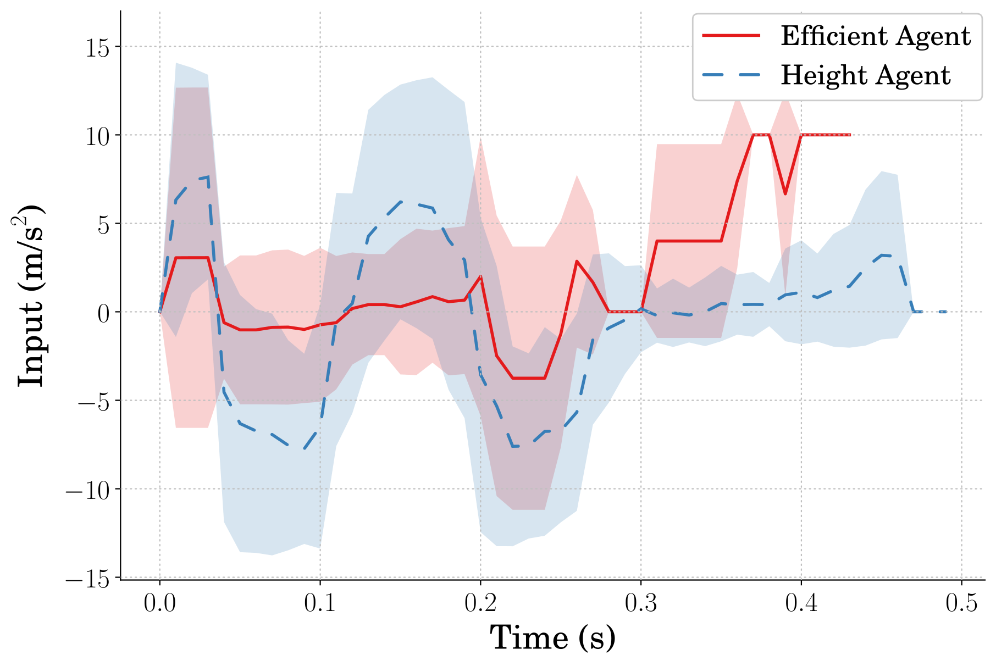
Learned Input
Notes:
How might these agents perform then?
Do the commands differ greatly based on the reward
Are the efficient agents more efficient?
These are also average performances
Agents do not always learn the exact same policy
Changes to things like hyperparameters and network design play a factor in the consistency of learning

Slide 29
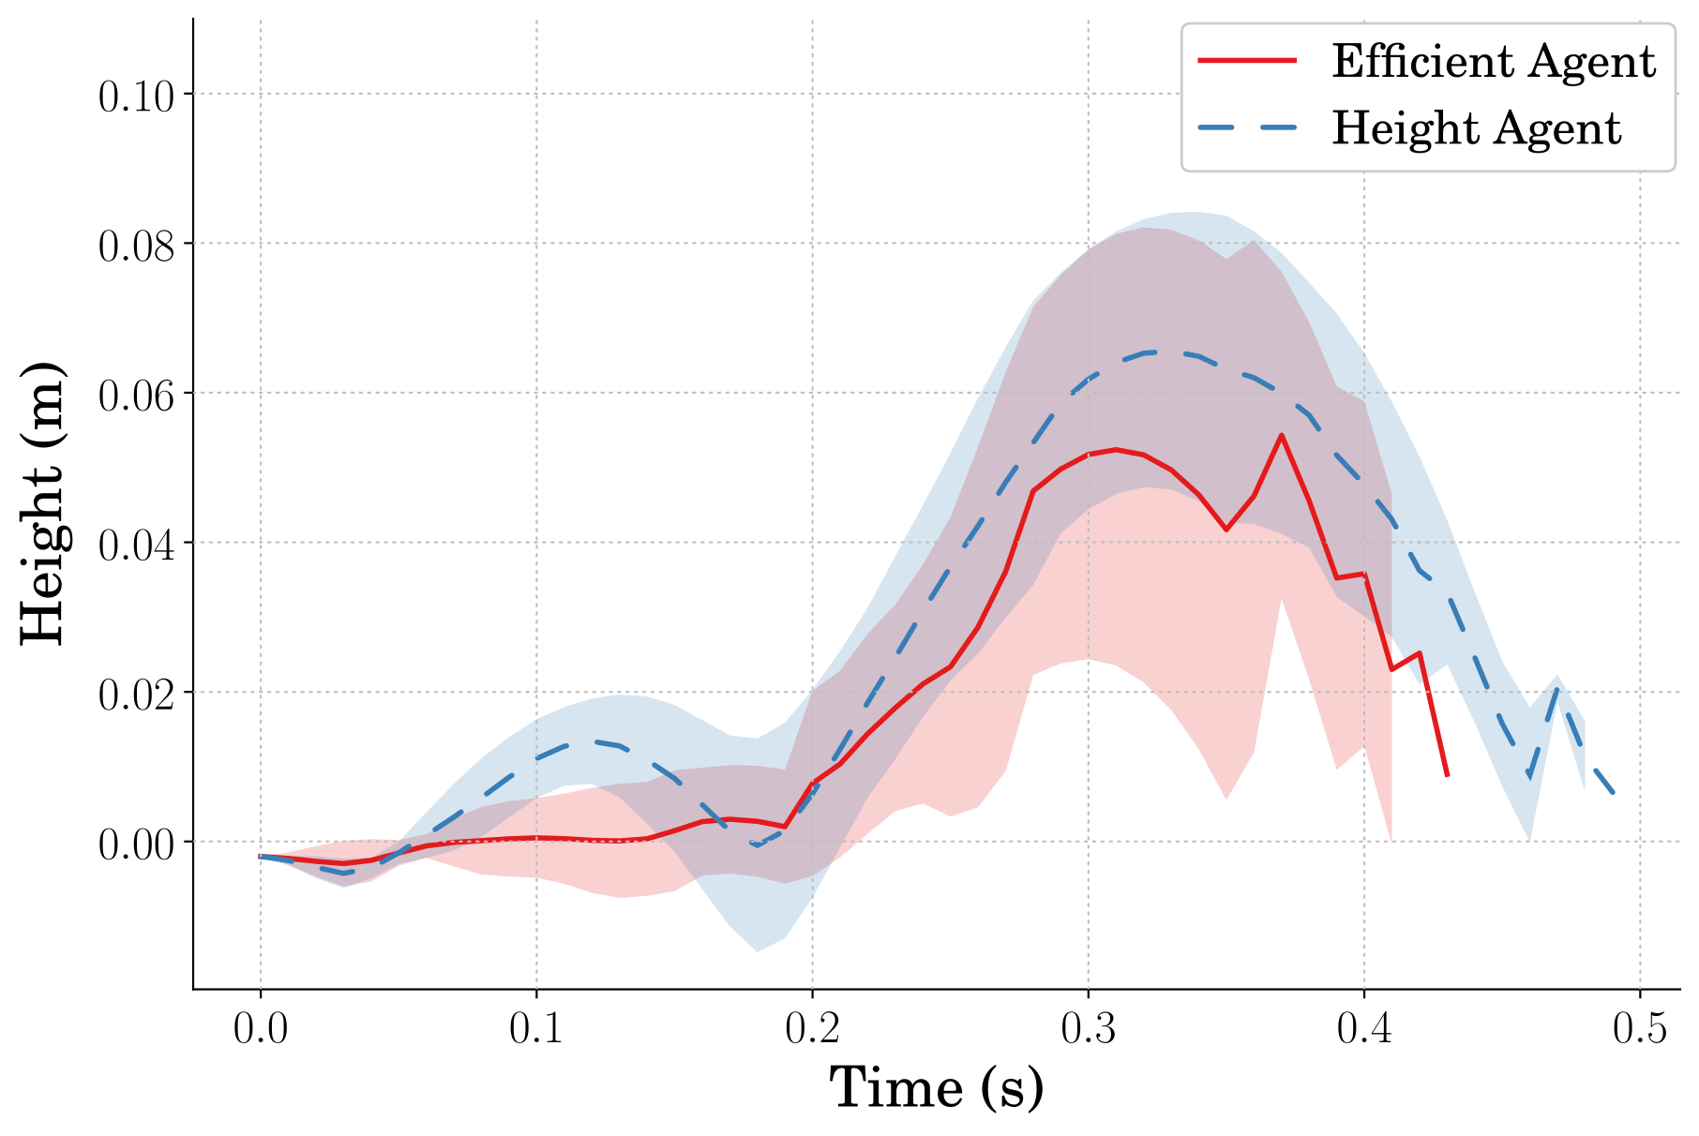
Jumping Response
Notes:
21% higher

Slide 30
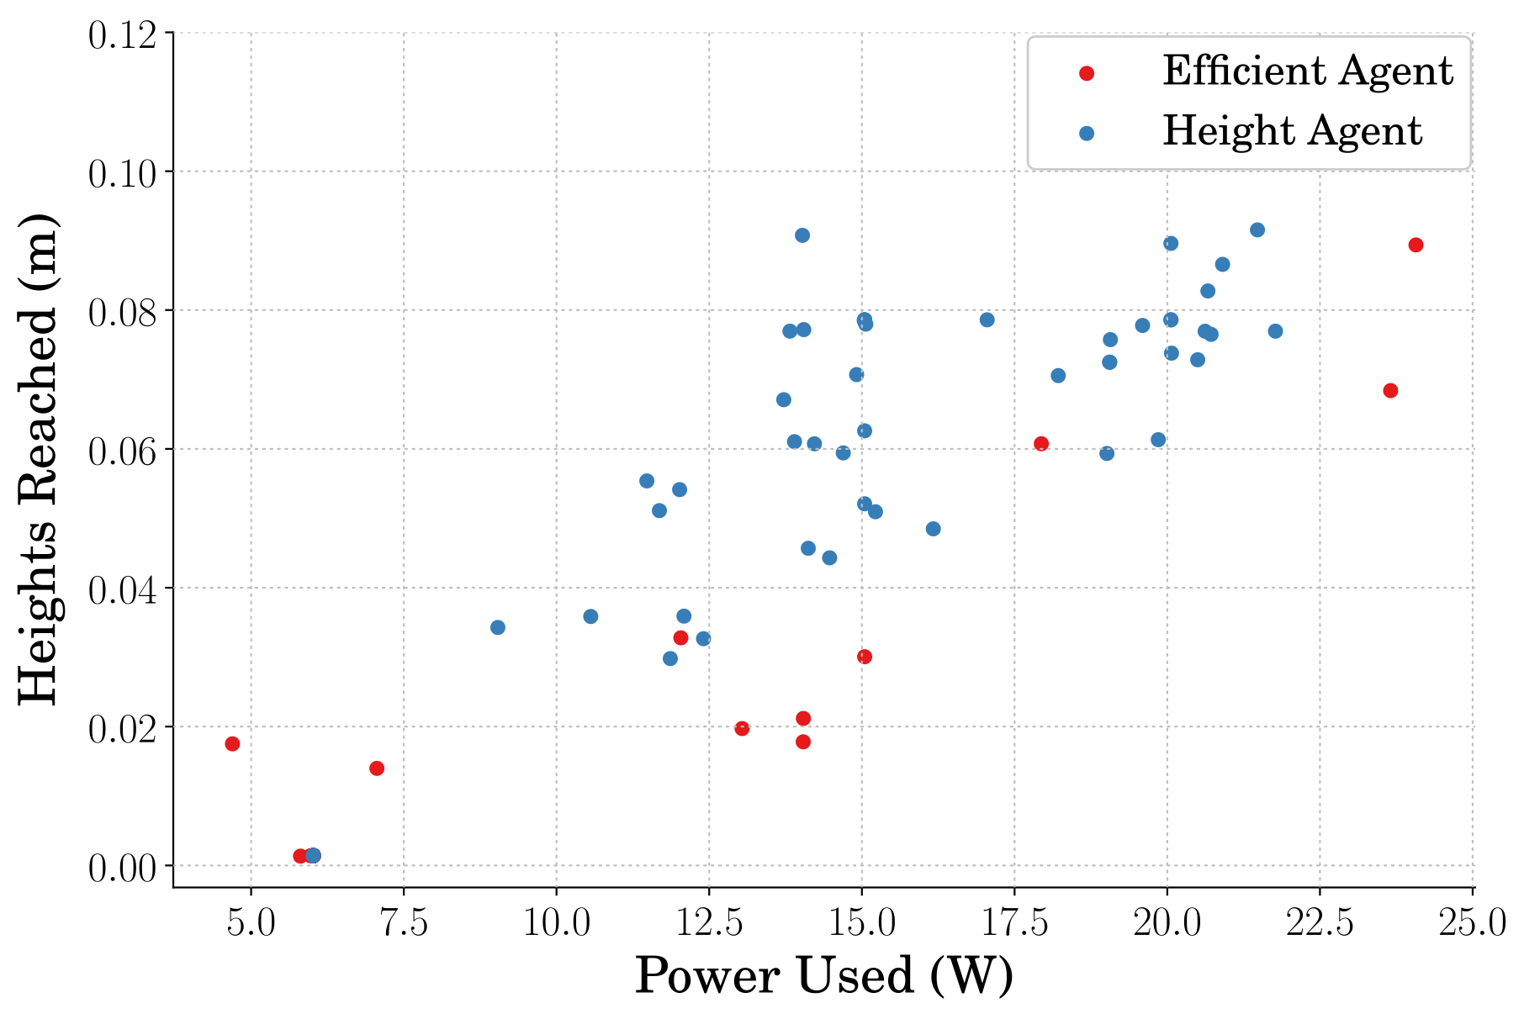
Stutter Jumping Efficiency
Notes:
101% more efficient

Slide 31
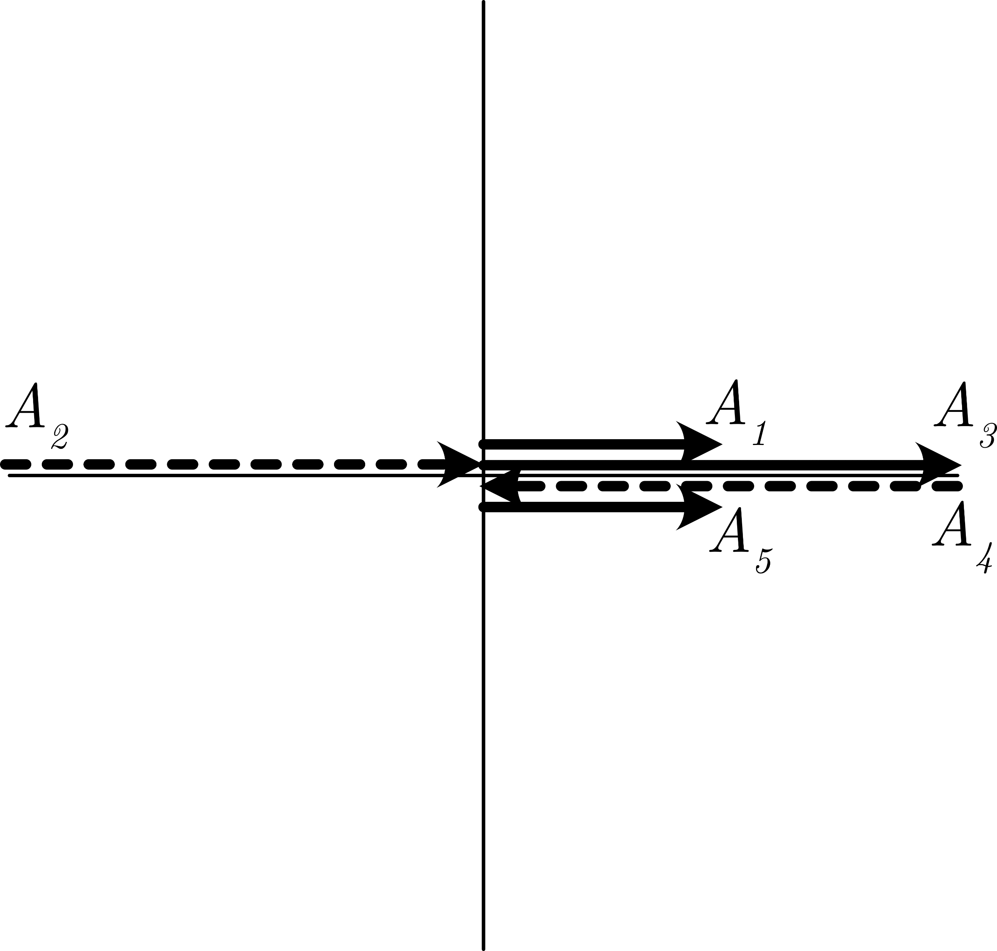
Evaluating the Jumping Response
Notes:
400% of what a single unity magnitude vector would create

Slide 32
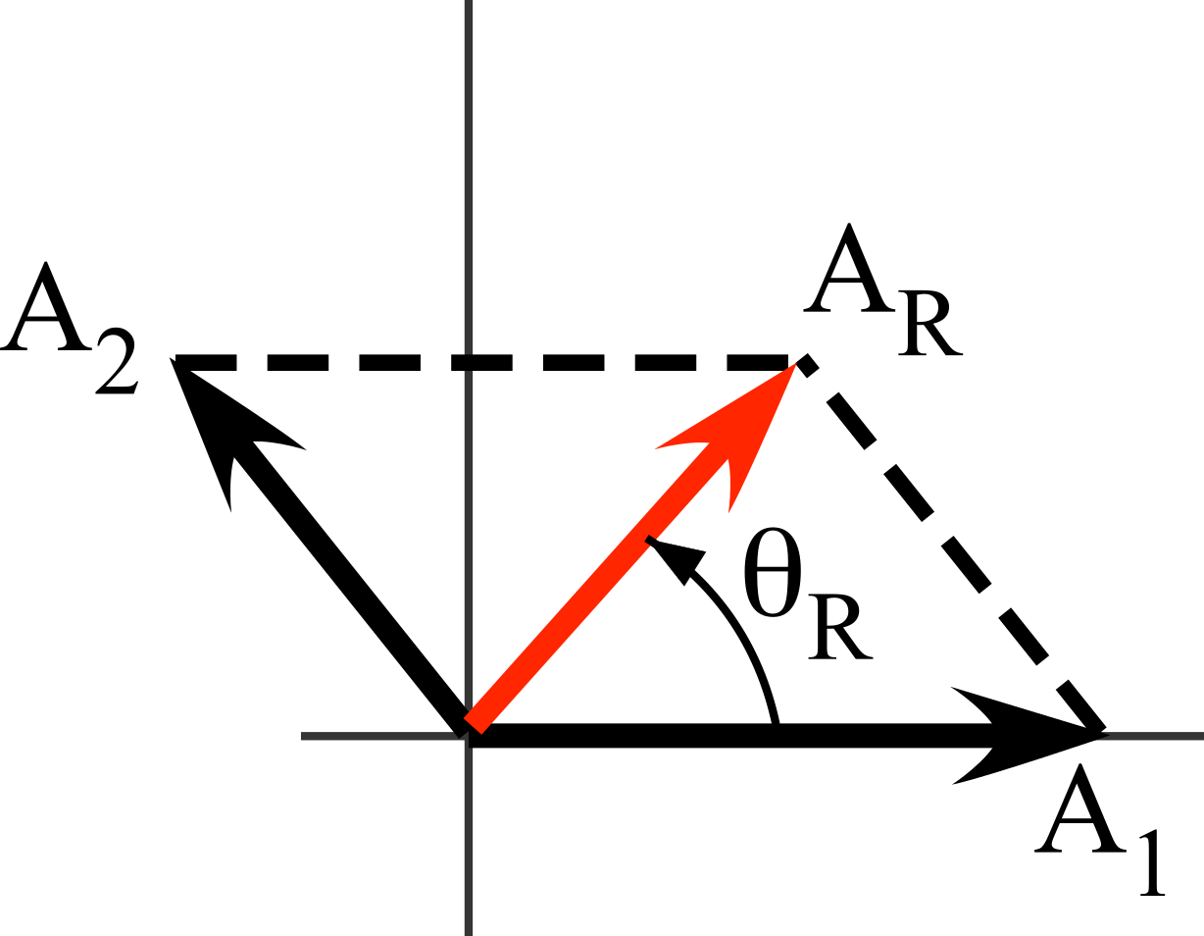
Vector Diagrams

Slide 33
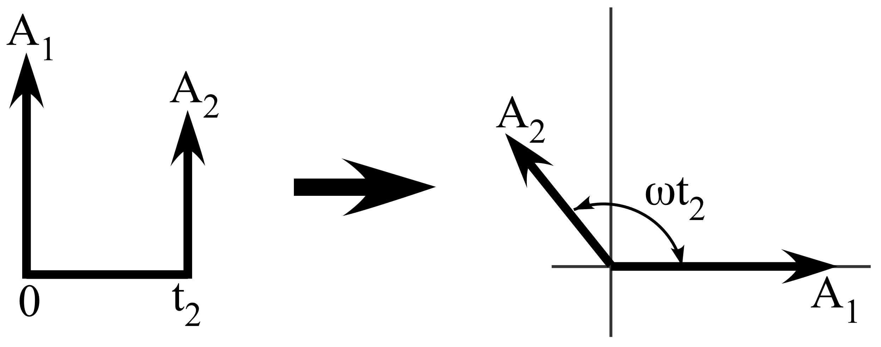
Vector Diagram Timing

Slide 34
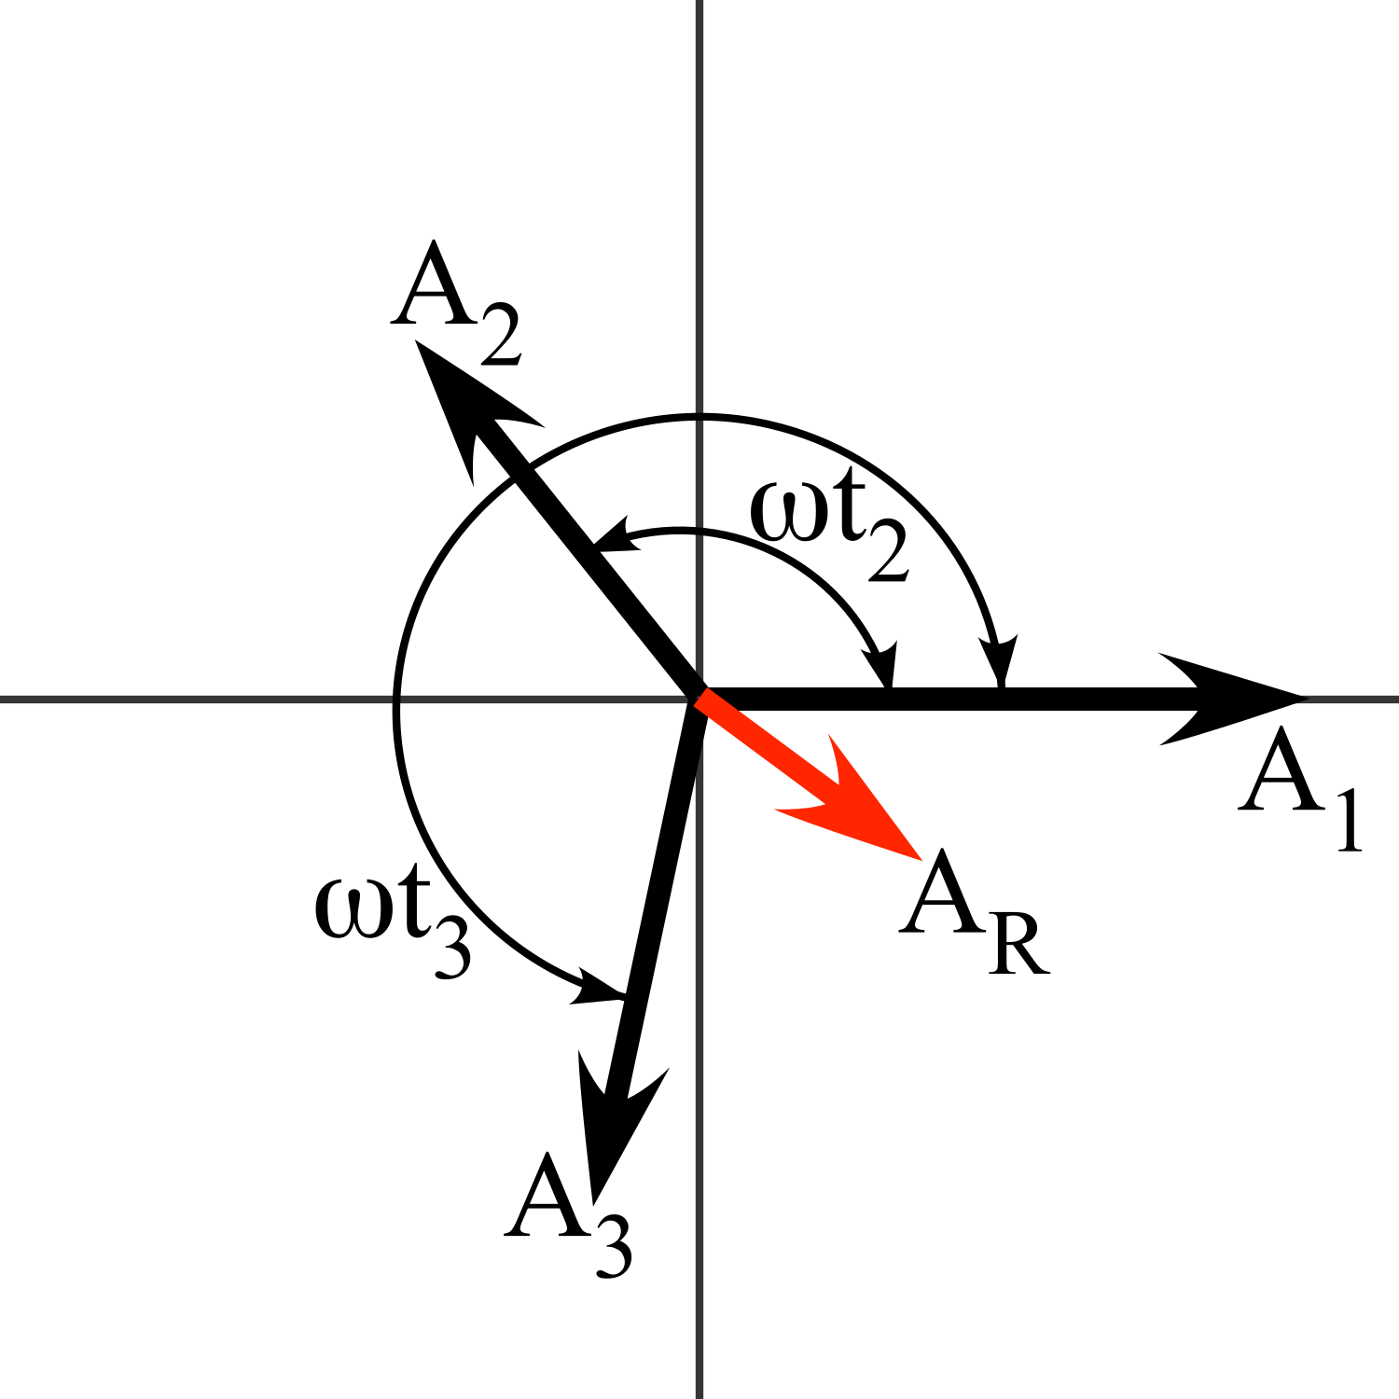
Vector Diagram Full

Slide 35
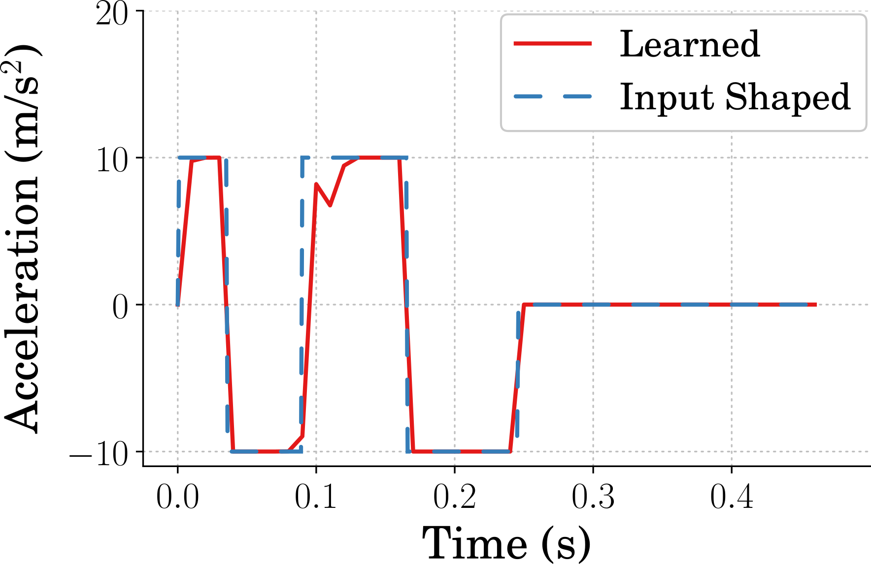
Shaped Command

Slide 36
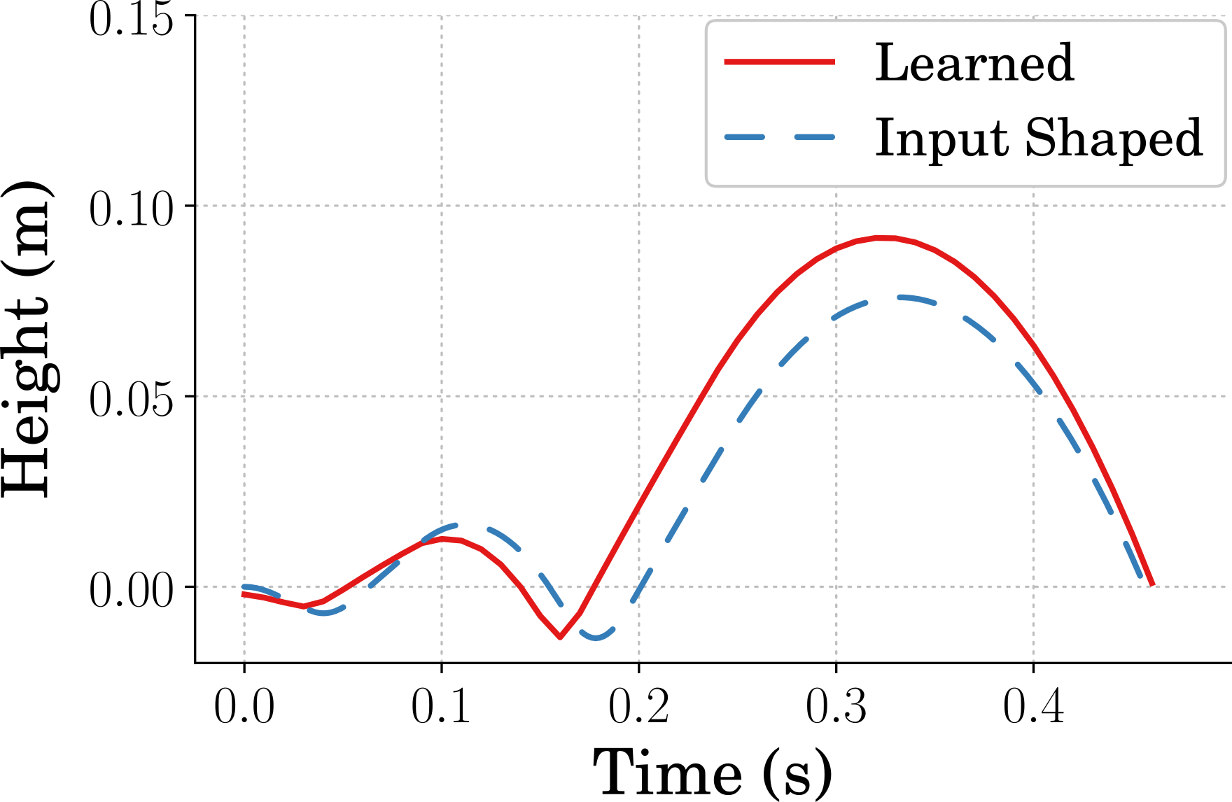
Shaped Response

Slide 37
Presentation Outline
Motivation for Work
Reinforcement Learning Overview
Related Work
Monopode System Overview
Learning Efficient Jumping Strategies
Learning Mechanical Design Parameters
Concurrent Design with RL
Future Research Enabled

Slide 38
Learning the Design
Notes:
What if we wanted to learn the design though?
What does that look like?

Slide 39
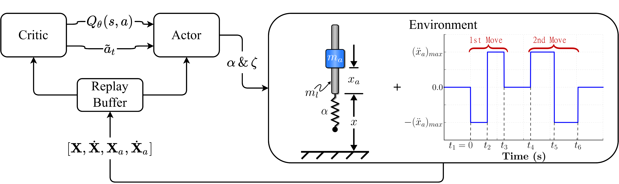
Learn Mechanical Design
Notes:
Start with a similar setup to what we had before.
The env is different though
Instead of sending control inputs we are sending design changes
What do the action and observation spaces look like then?
Well the actions are going to be design parameters
The observation is actually going to be timeseries sim data

Slide 40
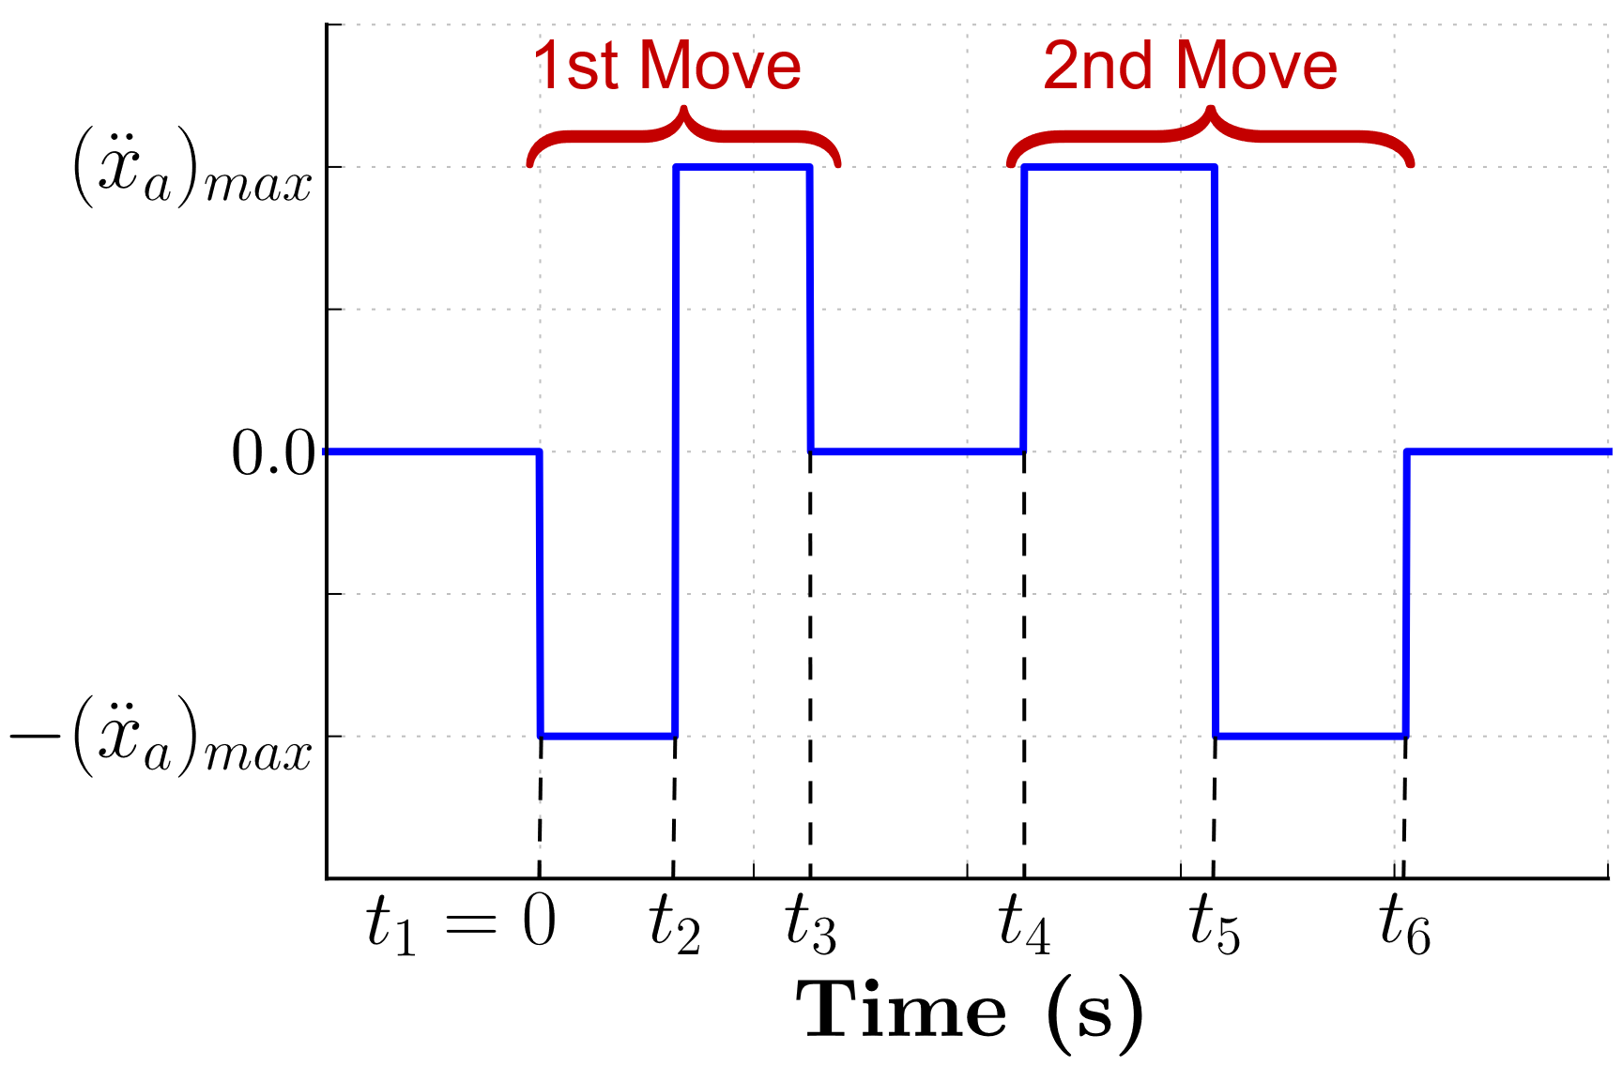
Simulation
Notes:
This is how the sim looks.

Slide 41
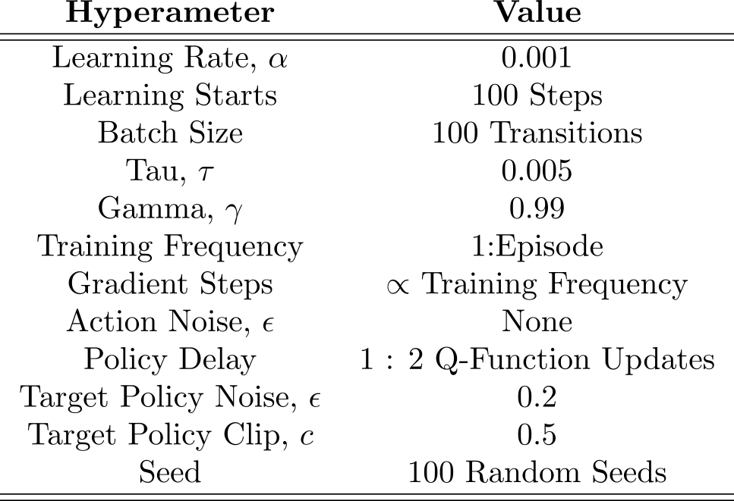
Training Hyperparameters

Slide 42
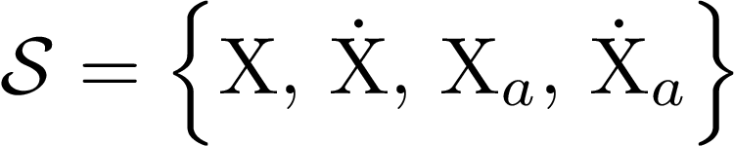
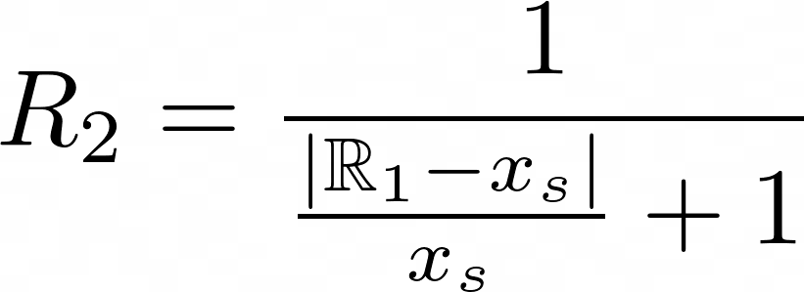
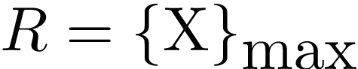
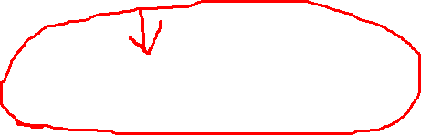
Gym Environment Setup
Environment Action Space
Environment Observation Space
Reward(s)
High
Reward
Specified
Reward

Slide 43
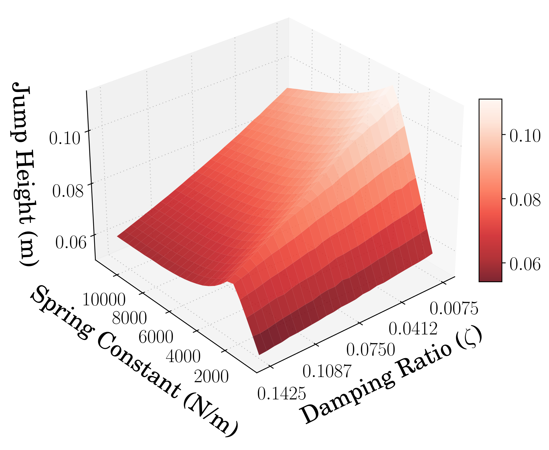
Design Performance
Notes:
Because we are only changing two parameters, it is easy to graphically evaluate what a good design would be.
We can use this to evaluate the agents performance as well.

Slide 44
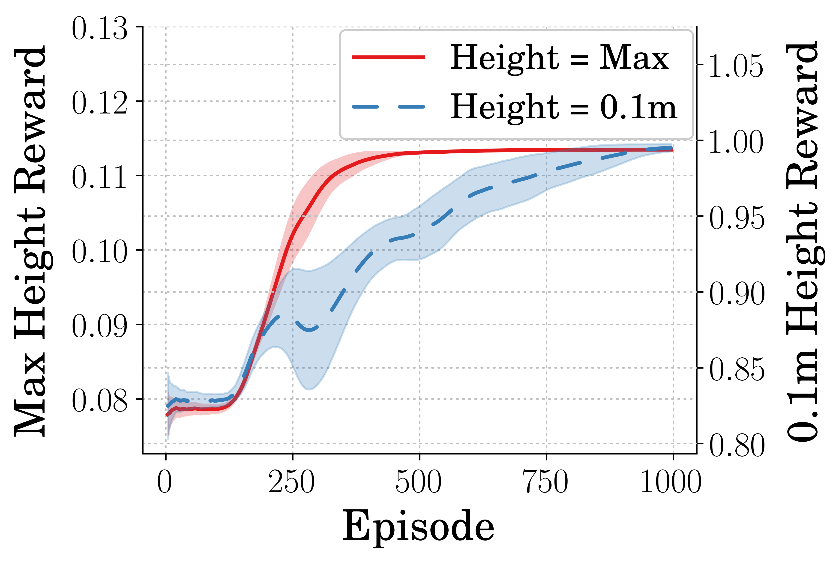
Training Reward vs. Time
Notes:
First and foremost, are the agents learning?
Is the reward converging?

Slide 45

Learned Spring Constant

Slide 46

Learned Damping Ratio

Slide 47

Training Height vs. Time

Slide 48

Learned Design Performance
Notes:
Final jumping performance

Slide 49

Learned Design Performance

Slide 50

Final Designs Learned

Slide 51
Presentation Outline
Motivation for Work
Reinforcement Learning Overview
Related Work
Monopode System Overview
Learning Efficient Jumping Strategies
Learning Mechanical Design Parameters
Concurrent Design with RL
Future Research Enabled

Slide 52
Concurrent Design

Slide 53
Concurrent Design

Slide 54

Concurrent Design

Slide 55

Concurrent Design
Notes:
Continuous vs Discrete

Slide 56
Concurrent Design

Slide 57


Concurrent Design
Notes:
Update Rate
This is what is discussed

Slide 58


Training Hyperparameters
Outer Loop:
Inner Loop:

Slide 59



Environment Setup
Learn Controller:
Learn Design:
High
Reward
High
Reward

Slide 60
Jump Type

Slide 61

Learning Reward

Slide 62

Learning Spring Rate

Slide 63

Learning Damping Ratio

Slide 64

Learned Input

Slide 65

Jumping Performance

Slide 66

Learning Reward

Slide 67

Learning Spring Rate

Slide 68

Learning Damping Ratio

Slide 69

Learned Input

Slide 70

Jumping Performance

Slide 71

Input Comparison

Slide 72

Height Comparison

Slide 73
Conclusion
Reinforcement learning for finding energy efficient jumping strategies
Energy efficiency scales with input complexity
Proper tuning of hyperparameters should lead to more consistent policies
Reinforcement learning can also be used to find mechanical parameters
Given a static control input
Different designs can be found to accomplish multiple tasks
A concurrent design architecture can be defined using RL as both the control and mechanical design optimizers
Changes to the implementation method can affect learning and performance
The mechanical update rate can make for a more difficult to learn policy

Slide 74

Beyond Toy Systems

Slide 75

Simulation for Training
Notes:
- How is flexibility represented?

Slide 76





Environment Setup
Learn Controller:
Learn Design:

Slide 77

Video of Jumping Performance

Slide 78

Consistency Learning

Slide 79

Future Research Enabled
Generative Design
Reinforcement Learning
Learning Generative
Design through Environment Interaction

Slide 80

Generative Design

Slide 81
Thank You.
Questions?

